Slide 1
PowerPoint 6 of 6
2026 Conference Agenda Report
私たちの文献の価格設定
Notes:
This is the sixth of six PowerPoints covering material in the 2026 Conference Agenda Report (or CAR for short).

Slide 2

2026 CAR
PowerPoints
Introduction to CAR
Motions
3. Gender-Neutral and
Inclusive Language
4. DRT/MAT in NA: Helping Members Take Root
5. Literature, Service Material, and Issue Discussion Topics survey
6. 私たちの文献の価格設定
Notes:
This PowerPoint covers the essay about pricing our literature.

Slide 3
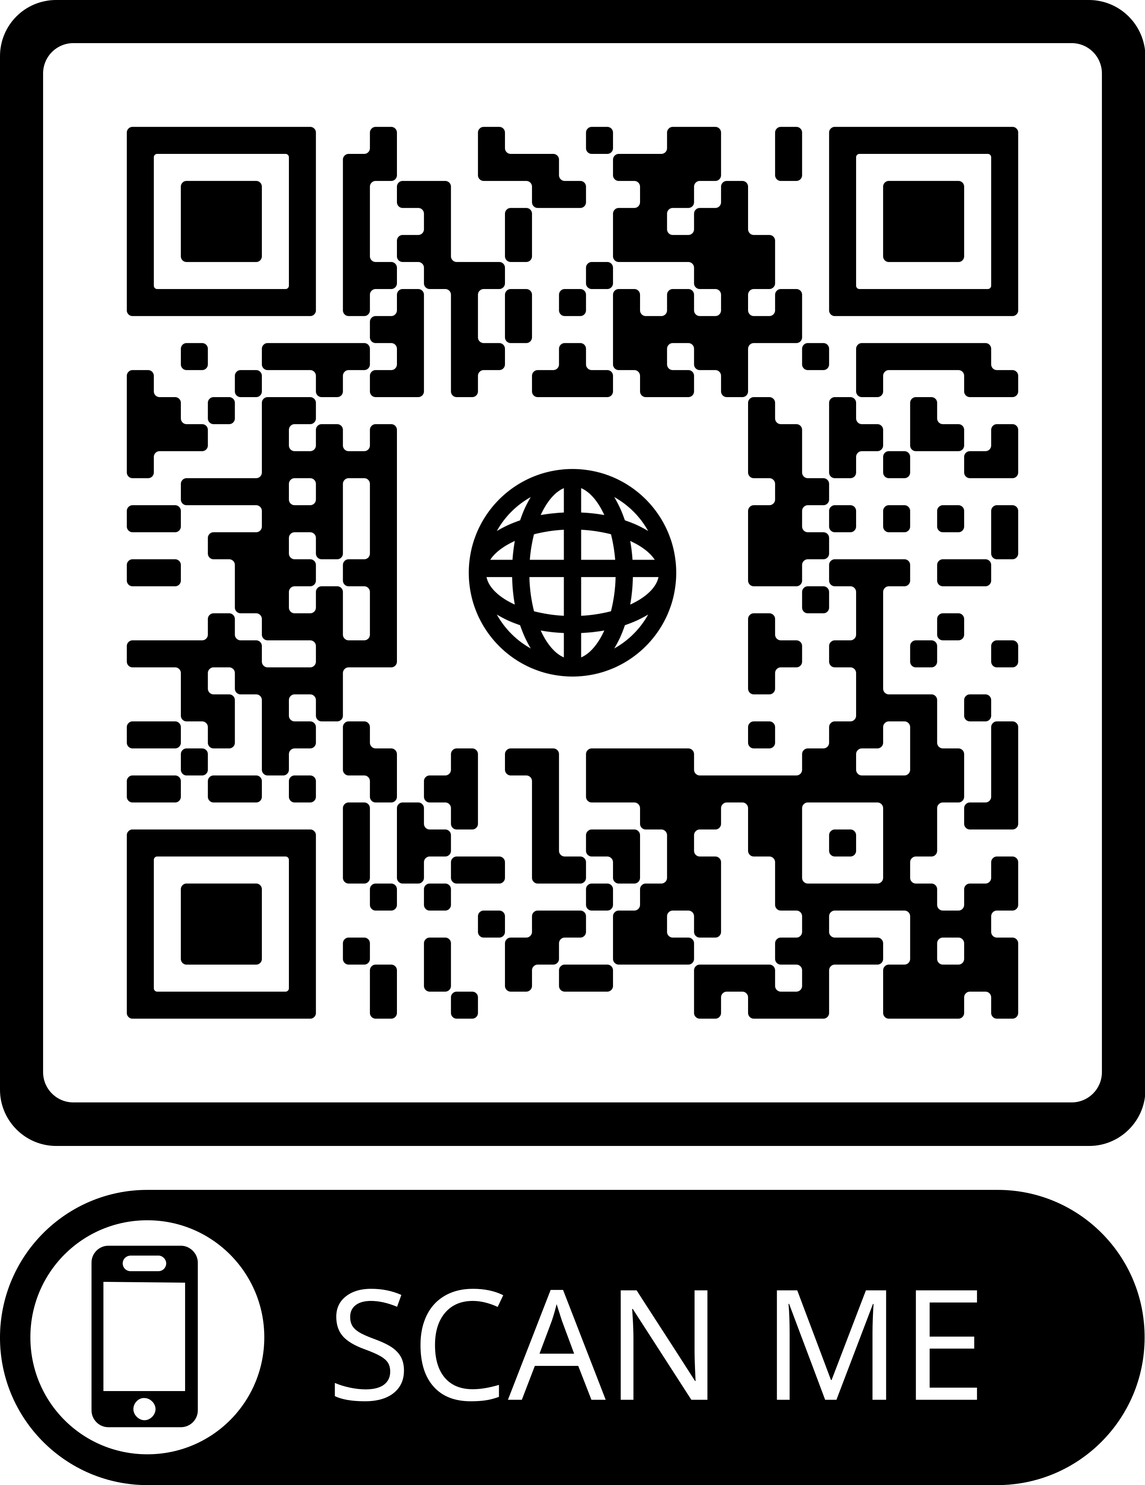
2026 CAR
PowerPoints
These PowerPoints only cover the main points of the CAR.
We encourage all members to read the CAR itself.
Please visit
na.org/conference
for the complete 2026 CAR.
Notes:
Please keep in mind, these PowerPoints only cover the main points of the CAR. We encourage all members to read the CAR itself. Please visit na.org/conference for the complete 2026 CAR, the other PowerPoints, and other conference materials. The CAR Survey and discussion question input forms are posted at na.org/surveys.

Slide 4
文献の価格設定
「私たちは、まだNAを見つけていないアディクトにメッセージを届け、ビジョンを実現するために、すべての資源を活用しています。」
— 2026年カンファレンスアジェンダレポート（CAR）
Notes:
When we talk about money in service, it often makes people uncomfortable—but it’s a necessary conversation. We need funds to keep our Fellowship moving forward: to pay rent so meetings can happen, to maintain phonelines and websites so newcomers can find us, and to provide literature that supports recovery between meetings. Every dollar spent toward carrying our message—whether on outreach, translations, or service travel—is both spiritual and essential.
Our financial resources allow us to reach addicts in all circumstances. From supporting Step work with incarcerated members, to providing literature on inmate tablets, to funding trusted servants’ travel and translations—these are all ways we fulfill our vision of carrying the message worldwide.

Slide 5
価格改定
2023年には、IP、小冊子、キータグやチップの価格は引き上げられませんでした。
印刷・製造・倉庫管理・物流のコスト上昇により、年間収益が推定で $671,000（約1億500万円） 減少する可能性があります。
2026年1月1日より、文献の価格を 15％引き上げ ます（※NAサバイバルキットは対象外）。
Notes:
Since 2023, NA World Services has held off on raising prices despite rising costs. But with ongoing financial pressures, a 15% price increase on literature will take effect on January 1, 2026. This change comes after years of absorbing increased expenses—printing, production, warehousing, and logistics—that have the potential to reduce World Services’ annual net income by an estimated $671,000.
The price adjustment ensures World Services’ continued ability to serve the Fellowship sustainably.

Slide 6
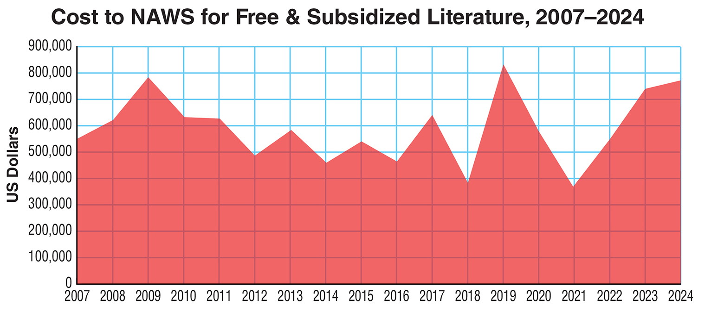
無料および補助付き文献
2024年度 = $769,958（約1億2,000万円前後）
Notes:
World Services provides free and subsidized literature to those who cannot afford it. In the 2024 fiscal year, NA World Services distributed over $769,000 worth of literature at reduced or no cost. Over the past five years, that number has averaged more than $635,000 annually, supporting members in correctional facilities and developing communities around the world.

Slide 7
提供可能性と持続可能性
文献は na.org で60言語以上で入手可能です。
ベーシックテキストの音声版は12言語で提供されています
入門ガイド の音声版は現在、英語とスペイン語で公開中です。
オンラインのすべての文献は、受刑者用タブレットでも提供され、100万人以上の収監中アディクトが利用可能です。
バーチャルNAの増加により、文献収益の減少がさらに進んでいます。
電子文献（eLit）の販売は低く、利益率も最小限です。
Notes:
NAWS also continues to make recovery IPs and booklets freely available online in more than sixty languages, and the Basic Text is now posted as an audio version in twelve. These same materials are also made available on inmate tablets at no cost to over one million incarcerated addicts. As the need for translations and accessible formats grows, so too does the financial investment required to meet that need.
The rise of virtual NA meetings has changed how members access literature. Many groups no longer maintain physical stock, and while digital access greatly expands our reach, it also lowers revenue. Electronic literature sales are still small, limited by pricing restrictions and higher distribution costs than most assume. What we gain in accessibility, we lose in income stability.

Slide 8

提供可能性と持続可能性
文献販売は、NAワールドサービスの主要な資金源であり続けています。
オンラインやタブレットでの提供により、年間で推定 100万ドル以上（約1億5,600万円） の収益が失われています。
近年、直接寄付がワールドサービスの運営を支えてきました。
Notes:
Literature sales remain the primary funding source for all these services. We face a growing challenge: maintaining free access to our message while ensuring financial sustainability. The materials NAWS provides online and through tablets represent an estimated over $1 million in annual lost revenue. Combined with rising operational costs, this places real pressure on NAWS’ ability to serve.
Direct contributions from members, groups, and service bodies have kept World Services afloat in recent years. Without them, service cuts or price increases would already have been necessary.

Slide 9
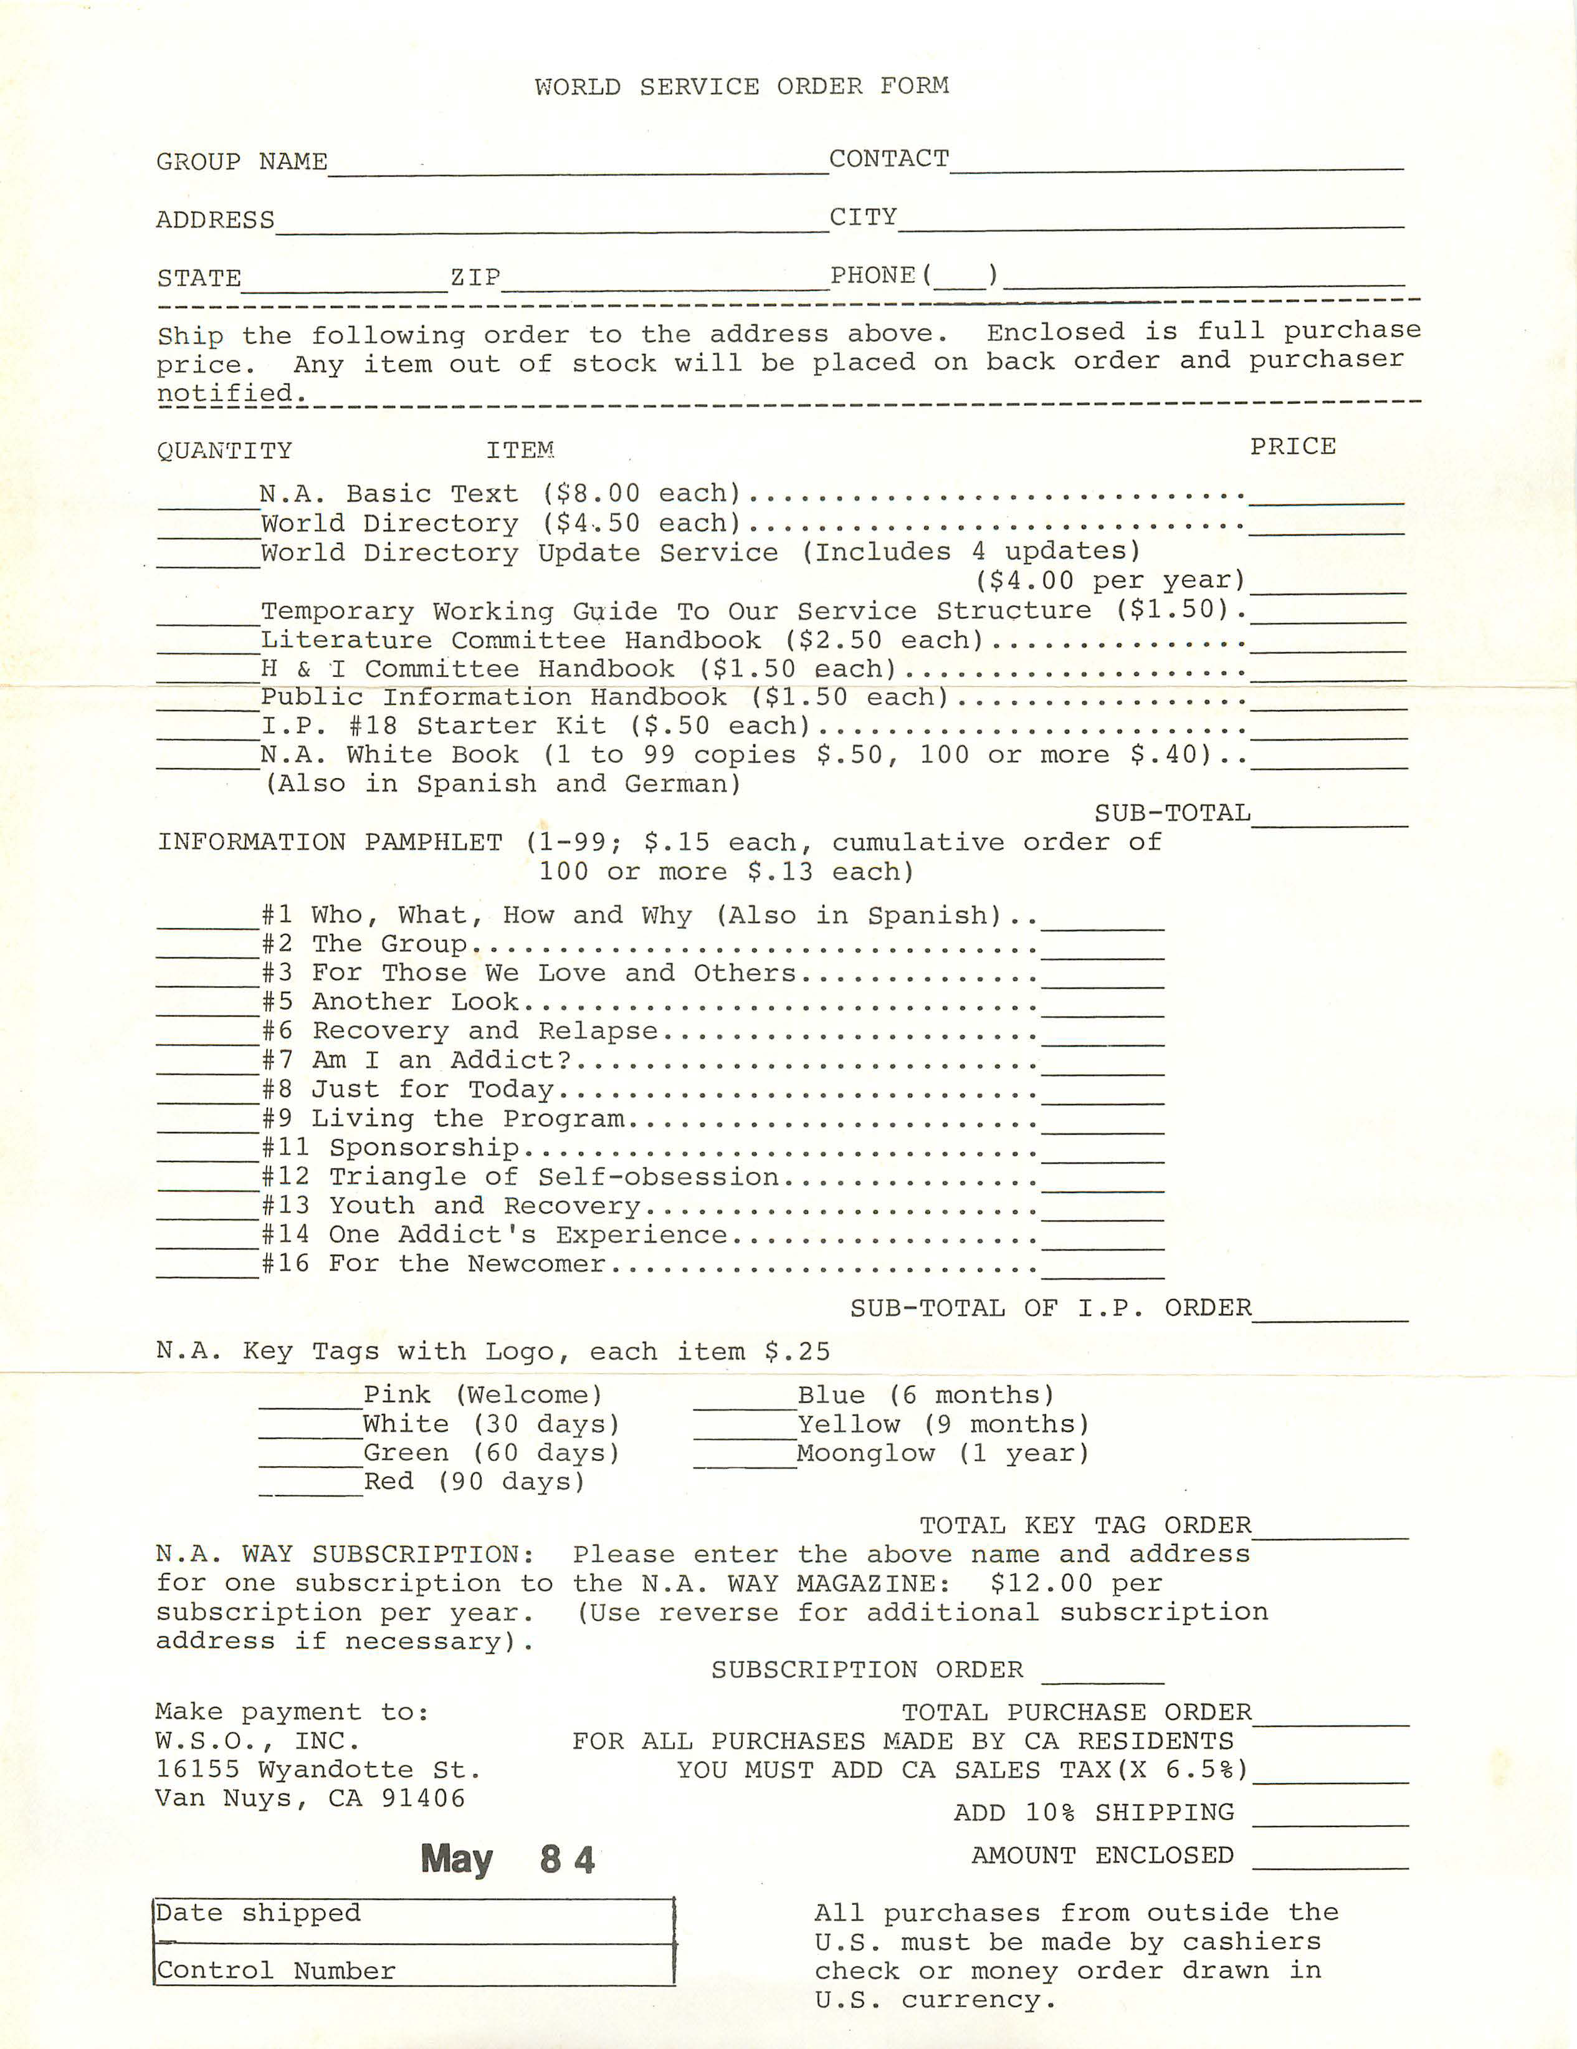

私たちには文献がある！
Notes:
The conversation about funding our service efforts has been part of NA’s story from the very beginning. Before the Basic Text was published, the World Service Office faced constant financial struggle. That changed in April 1983, when the Basic Text was released. The price was set at $8.00, intentionally split — half for producing more books and half for funding Fellowship services.

Slide 10

低価格なベーシックテキスト
1983年以降、ベーシックテキストの価格引き下げを求める動議は 19件 ありました。
フェローシップはこれらの動議を支持したことはありません — 文献販売が必須サービスの資金源であることを理解しているからです。
低価格本を求める声の一部は、ベーシックテキスト初期の問題に由来しています。初めの5年間で5版が発行され、その過程で議論が生じたためです。
Notes:
Since 1983, there have been 19 motions to lower the cost of the Basic Text or increase discounts. The Fellowship has never supported such a motion — understanding that literature sales fund our essential services.
Some of the push for lower-cost books comes from distrust that dates back to the 1980s. The Basic Text went through five editions and one revision in just over five years, and the process of those revisions was often contentious.
While these issues were settled through Fellowship decision-making, some still question the legitimacy of those outcomes.

Slide 11
非公式な文献
フェローシップは繰り返し、NAワールドサービスがNA文献の唯一の出版社および配布者であり、最新の版のみがNAミーティングで使用できる承認済みの版であることを確認しています。
Notes:
The Fellowship has repeatedly affirmed that NA World Services is the exclusive publisher and distributor of NA literature and the most recently published edition of the text is the only approved edition for use in NA meetings. Nonetheless, some members have printed different editions of Fellowship-approved literature or outside, often machine, translations. NA World Services works alongside communities helping them to develop their own translations. These efforts don’t simply translate words—they convey the spiritual principles and recovery.

Slide 12
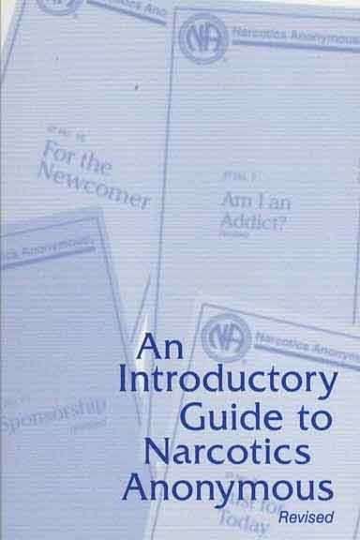
入門ガイド
低価格オプションの要望に応えるため、フェローシップは 『An Introductory Guide to NA（NA入門ガイド）』 を作成しました。
10のIPとベーシックテキストの12ステップの章を組み合わせた内容です。
価格は 2026年1月より$2.45（約380円） オンラインでは na.org/ips および na.org/audio で無料で入手可能です。
Notes:
Many who ask for a cheaper Basic Text simply want to help newcomers get a book.
To address ongoing calls for lower-cost options, the Fellowship created An Introductory Guide to NA.
The Intro Guide combines ten IPs with the Twelve Steps chapter from the Basic Text — all for $2.45 starting January 2026.
It’s also available free online and will soon include audio versions in English and Spanish.
This guide helps reach members and potential members who might not yet be ready for the full Basic Text.

Slide 13
大部分／圧倒的な割合
1983年のベーシックテキスト $8（約1,250円） のインフレ換算額 = 現在 $26（約4,060円）
2026年1月1日より適用価格 = $15.65（約2,440円）
2024年 – 401,000部 販売（全書籍販売の39％）
1983年以降 – 1,340万部以上 販売（販売された書籍の半数以上
Notes:
Even now, the Basic Text remains very affordable. That same $8 price from 1983 equals over $26 today — yet the current price is $15.65.
It still makes up the lion’s share of World Services’ income. In fiscal year 2024, over 401,000 copies were sold, making up 39% of all book sales. Since 1983, more than 13.4 million copies have been distributed — over half of all books ever sold by NA.

Slide 14
財務管理／運営管理
グループは、回復のメッセージを伝える努力を妨げるように思える決定、例えば文献の価格引き上げの必要性などに直面して悩むことがあります。
しかし、全体の地域やコミュニティ—私たちの全体の福利—のために何が必要かを広い視点で考えることが重要です。
Notes:
Stewardship is hard. As trusted servants, we want to do what’s best for our home groups, our service bodies, and our wider Fellowship.
Being frugal with finances is one of the easiest ways to practice stewardship. NA World Services works hard to be fiscally responsible. Despite rumors or misconceptions, there are no lavish expenses or hidden luxuries — just dedicated trusted servants and staff who give countless hours to support our primary purpose.
Groups may struggle with a decision that seems to impede their efforts to carry a message of recovery, for instance, the need to increase the price of literature. Until we zoom out to consider what is necessary for the whole neighborhood or community—our common welfare. Empathy reminds us that we’re all striving for the same outcome — to carry the message of recovery, everywhere it’s needed.

Slide 15
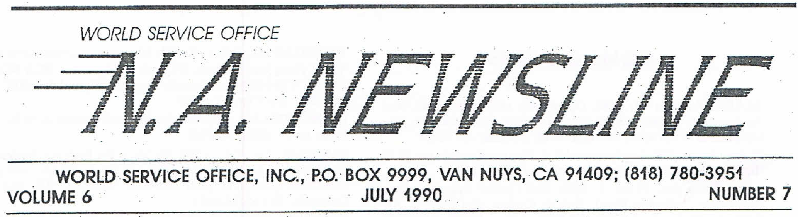
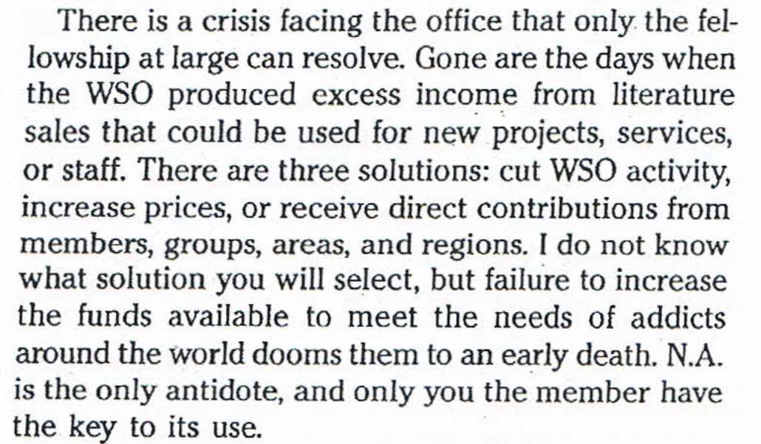
Notes:
Funding services through literature sales has always been part of NA’s story. Even in earlier years, when the WSO and WSC operated separately, income shortfalls were common. In a letter from 1990, the departing office manager identified the same three choices we face today: cut services, raise prices, or increase direct contributions.
Our ongoing efforts to sound the alarm about the need to increase direct contributions have not yet yielded the results necessary to reduce our reliance on literature sales.

Slide 16
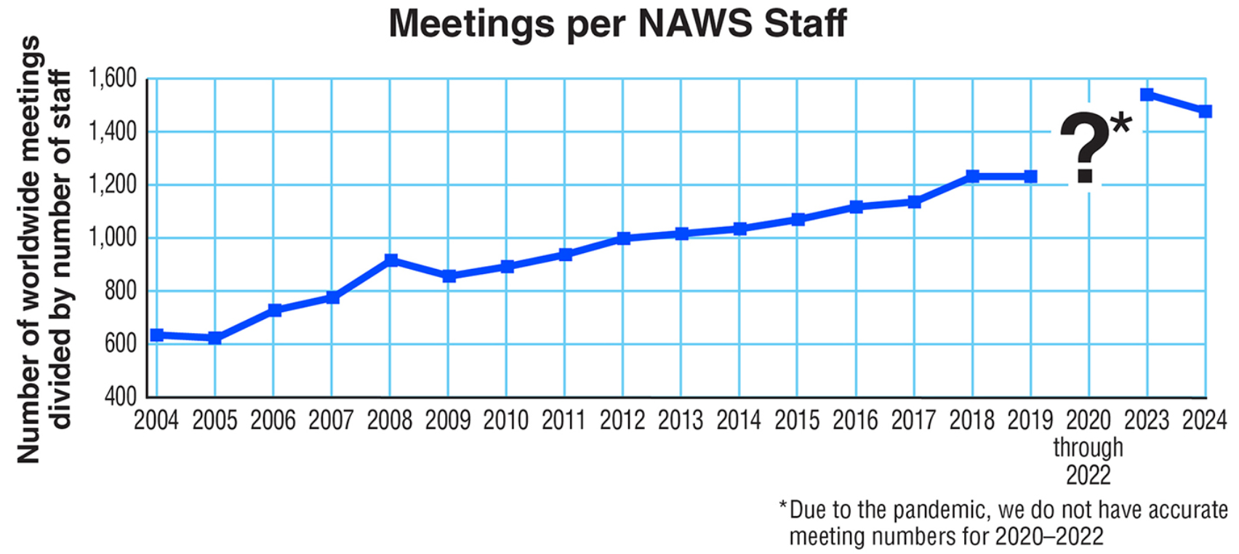
Notes:
A 1987 report stated that World Services had 38 staff in the US, three of whom were part-time or temporary, plus one open position. In 1987, there were 11,082 NA meetings worldwide, one NA book, and literature published in four languages. Today we have 37 staff in the US as well as locations and additional staff in Europe, Iran, Canada, and India. As of WSC 2023, there were 72,215 meetings, seven NA books, and literature published in 58 languages. Considering this, World Services has done extremely well at maintaining its ability to “do more with less

Slide 17
答えは？
直接の定期的な寄付がなければ、この問題はもっと早く、より深刻に表面化していたでしょう。そのため、私たちは寄付してくれるメンバーに感謝しています。
ワールドサービスの目標は、月次で 3,000件の定期的なメンバー寄付 を増やすことです。
現状では月約 1,000件未満、平均寄付額は $28（約4,370円） です。
この平均額のままでは、完全な自立を達成するには 2万人以上の寄付者 が必要になります。
Notes:
We’d love to live in a world where most of World Services’ income comes from direct contributions — but we’re not there yet. Unless we shift our shift our thinking and belief about how to fund services in our Fellowship, especially World Services, the same hard choices — price increases, service cuts, or increasing direct contributions — will keep returning.
Still, World Services is extremely grateful for those who have risen to the call. For the second and third time ever, the 2024 and 2025 (unaudited) fiscal years ended with just over two million in contributions from the Fellowship. Without those contributions this would have been a much larger issue that arose sooner.
It is now a goal of World Services to increase the number of monthly recurring contributions to 3,000. This is a small step toward sustainability from direct contributions. At the time of this writing, that number is just under 1,000, with an average contribution amount of just over $28.00. At that average, it would take more than 20,000 members to reach the goal of complete self-support.

Slide 18
na.org/contribute
すべての直接寄付は重要です。メンバー、グループ、またはサービス団体は、na.org/contribute を通じて寄付することができます。
Notes:
Every direct contribution matters. Any member, group, or service body can give through na.org/contribute.

Slide 19
Five other PowerPoints available online
CAR survey available online
CAR available for download
      worldboard@na.org
      na.org/conference
Notes:
We hope this PowerPoint has helped in your discussion of this material. Please note that there are five other PowerPoints that focus on the rest of the CAR. These resources, the CAR itself, and the online CAR survey and discussion question input forms are available online at na.org/conference.
We welcome your questions and your feedback on the CAR, and all other issues, at worldboard@na.org.

