Slide 1
PowerPoint 2 of 6
2026 Conference Agenda Report
動議
Notes:
This is the second of six PowerPoints covering material in the 2026 Conference Agenda Report (or CAR for short).

Slide 2

2026 CAR PowerPoints
CARの概要
動議
3. ジェンダー中立で包括的な言葉遣い
4. NAにおけるDRT／MAT：
メンバーが根づくのを支える
5. 文献・サービス資料・課題ディスカッショントピックに関するサーベイ
6. NA文献の価格設定
Notes:
This PowerPoint covers the five motions being offered in the CAR—3 World Board motions and 2 regional motions

Slide 3

2026 CAR PowerPoints
これらのPowerPointは、CARの要点のみを扱っています。
すべてのメンバーに、CAR原文を直接読んでいただくことを勧めています。
2026年版CARの全文については、na.org/conference をご覧ください。
Notes:
Please keep in mind, these PowerPoints only cover the main points of the CAR. We encourage all members to read the CAR itself. Please visit na.org/conference for the complete 2026 CAR, the other PowerPoints, and other conference materials.

Slide 4
ワールドボードからの動議
動議1：IP21『孤立の中でクリーンであり続ける』の改訂を承認する
動議2：共同で策定された2026～2029年NAWS戦略計画を採択する
動議3：NAワールド・コンベンションのガイドライン変更を承認する
Notes:
First we will cover the World Board Motions, which are:
Motion 1—approve the revision of IP #21, Staying Clean in Isolation
Motion 2—adopt the collaboratively created 2026–2029 NAWS Strategic Plan
Motion 3—approve changes to the World Convention of NA guidelines.

Slide 5

IP #21 改訂の背景
2019年11月 — 文献サーベイがCARに掲載され、配布
2020年3月 — 世界的なロックダウン
2020年WSC — 初の完全オンライン形式でのワールドサービスカンファレンス
カンファレンスは、この作業を2020〜2023サイクルで優先することに合意しました。
最初のサーベイが配布され、初めて孤立状態でクリーンを保っているメンバーから意見が集められました。
しかし、緊急事態の性質により、このプロジェクトは一時棚上げとなりました。
2023年に再優先事項として位置づけられ、改めて取り組んだときには、フェローシップとしての私たちの経験は大きく変化していました
Notes:
In November 2019, the literature survey went out in the CAR.
In March 2020, the global shutdown began.
WSC 2020 was the first all virtual World Service Conference. Through the CAR survey members expressed interest in revising IP #21, The Loner: Staying Clean in Isolation. The conference agreed with prioritizing this work for the 2020–2023 cycle. The first survey on the subject went out and input was collected from members who were staying clean in isolation for the first time. However, the nature of the emergency led to the project being shelved.
It was reprioritized in 2023 and when we came back to it, our experience as a Fellowship had transformed.

Slide 6

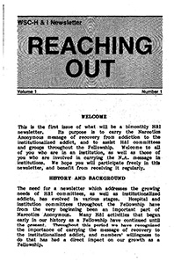
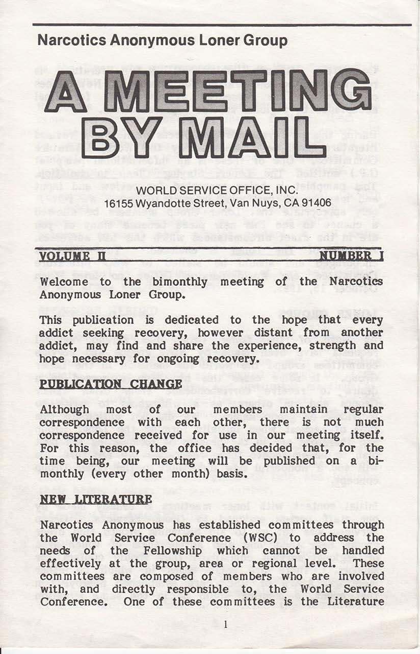
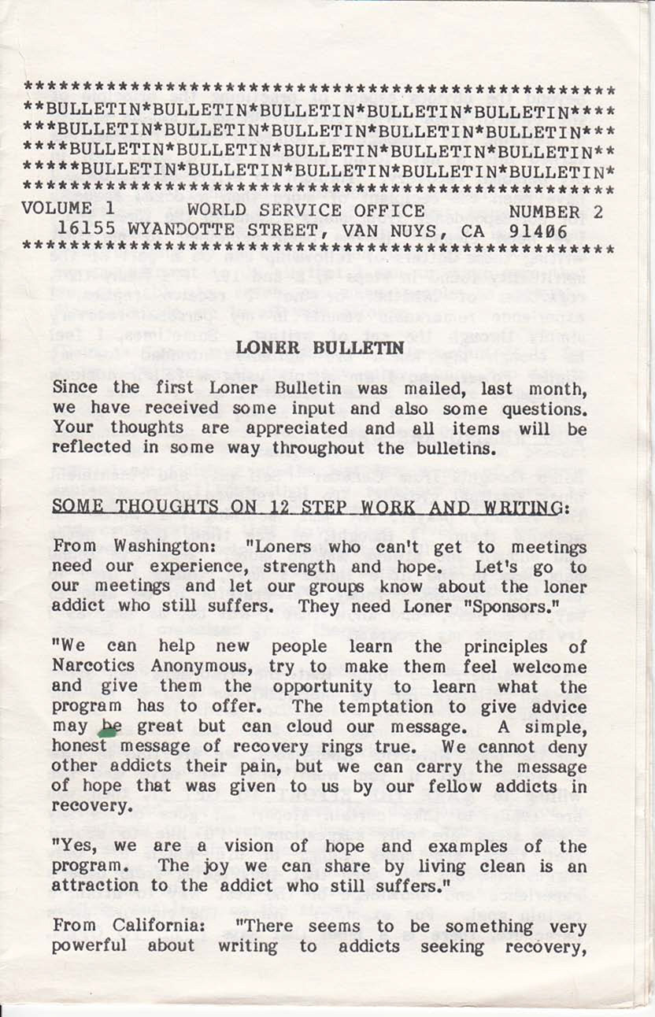

現在
1980年
Notes:
Had we tried to work on the revision any earlier it would have been outdated before it was printed. The delay meant we could draw on resources and experiences that simply had not existed prior. Between 2020 and today, virtual meetings have become commonplace in our Fellowship and our lives together have in some ways become more interconnected than ever. There are resources available for isolated members today that could not have been imagined when this IP was first drafted in the early 1980s.
At that time, in response to the growing number of letters that were pouring into the World Service Office from addicts around the world, the World Service Office created the Loner Group to put isolated members in touch with one another as pen pals. It was during this time that two publications were created: Reaching Out, for those incarcerated, and Meeting by Mail, for those isolated by distance, physical and mental health challenges, and other reasons, such as caregiving or military service, that kept people from being able to attend meetings in person.

Slide 7
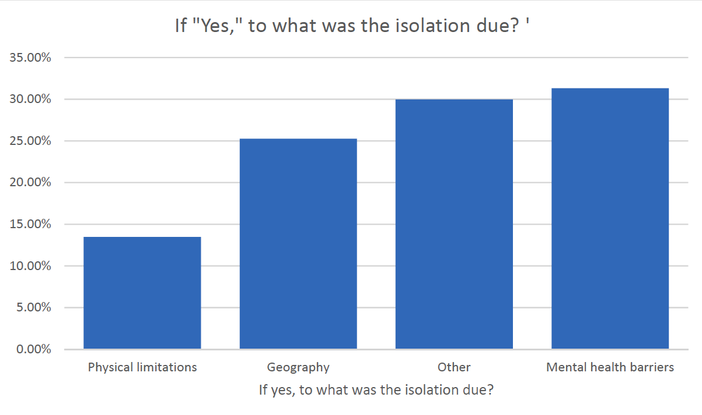
フェローシップの声によって形づくられた
from 2023 Conference Report
2022年2月〜8月：サーベイが実施されました 2023〜2026年サイクル：
プロジェクト作業やフォーカスグループ
への参加に関心のあるメンバー向けに、
ボランティア申込フォームが公開されました。
2つのフォーカスグループが設けられ、参加者には次の点について自身の経験を共有してもらいました。
・孤立に至った要因は何だったか
・孤立の経験の中で、何が特に困難だったか
・その経験の中で、変化や成長につながった点は何だったか
・どのようなツールやリソースが役に立ったか
Notes:
We could not have known the many ways in which circumstances would drive innovation in our Fellowship, the expanding pool of experience in isolation or the increasing importance of this subject for so many of our members. From February to August 2022, a survey was posted. More than 500 responses from 33 countries and 45 US states showed some surprising results: Less than 25% of those reporting isolation in recovery were experiencing it as a result of geographic isolation, and technology was rapidly shifting the landscape. (The 2023 Conference Report includes a summary of the survey data.)
The project was reprioritized at the 2023 WSC, and in the 2023–2026 cycle, World Services posted a volunteer form for members interested in project work and focus groups. From the members who had expressed interest and had experience with isolation two focus groups were formed. In these virtual conversations, participants were asked to share their experience: what had led to their isolation, what made the experience of isolation difficult, what about the experience was transformative, and what tools or resources had helped them. Their input was beautiful, brilliant, and highly emotional.
One message that was heard resoundingly in both the survey and focus groups was that there are many reasons beyond geographic location that someone might find themselves in isolation, and whatever the reason, they don’t much appreciate being called “loners.” Hence dropping that from the title.

Slide 8
動議 1：IP21『孤立の中でクリーンであり続ける』改訂版（付録Aに掲載）を、フェローシップ承認済み回復文献として承認し、現行のIP21『ザ・ローナー：孤立の中でクリーンであり続ける』に置き換える。
提案者：ワールドボード
意図：1986年に承認されたこのIPを、現在のフェローシップの経験に基づいて更新すること。
財務への影響：現時点ではなし。
影響を受ける方針：なし。
ここでディスカッション用の一時停止
Notes:
Motion 1: Approve the revised IP #21, Staying Clean in Isolation, contained in Addendum A, as Fellowship-approved recovery literature to replace the current IP #21 The Loner—Staying Clean in Isolation.
Maker: World Board
Intent: To update this IP originally approved in 1986 with current Fellowship experience.
Financial Impact: None at this time.
Policy affected: None
pause for discussion

Slide 9

NAWSの戦略計画は新しいものではありません
from 2016 Conference Approval Track
NAワールドサービスは、20年以上にわたって戦略計画のもとで運営されてきました。 新しい点は、その計画を採択することが、今回あらためて求められているということです。
この計画は改訂・更新されてきたもので、これまではカンファレンス承認トラック（CAT）資料に含まれていました。 今回初めてCARに含められています。 また、カンファレンス全体によって作成されたのも、
これが初めてです。
current plan is in Addendum B in the CAR
Notes:
The NAWS Strategic Plan isn’t new. NA World Services has operated with a strategic plan for over 20 years. What is new is that you are being asked to adopt the plan.
For every conference, the plan is revised and renewed, and the priorities in the plan help shape the work for the cycle ahead. In the past, the NAWS Strategic Plan was included in the Conference Approval Track material. This is the first time it has been included in the CAR and it’s the first time it has been created by the conference as a whole. All conference participants have been involved in every stage of co-creating the plan which is Addendum B in the CAR.
Creating and adopting the strategic plan collectively and collaboratively is part of a larger shift from a motion-driven service culture to one characterized by discussion and consensus-building.

Slide 10
戦略計画とは何か？
現在にしっかりと立ちつつ、これから起こることに備える。
一歩ずつ進み、その都度、方向性と進捗を確認する。
NAの内外にある要因に関連した変化を導き、ワールドサービスがより適切に対応していく必要がある点を示す。
これらの目的と解決策は、ワールドサービスで現在継続して行われている業務に加えて実施される、新たな取り組みやアイデアに関するものである。
この計画は次のサイクルである2026年〜2029年を対象としたものであり、あらゆる可能性を網羅するものではなく、現時点で重点的に取り組むことができる部分のみを示している。
Notes:
Planning allows us to live in the present while we prepare for what is to come. Planning allows us to proceed step by step, and to check our direction and our progress. The strategic plan guides change related to factors within and outside NA that may affect our ability to carry the message. The plan’s objectives and solutions are about new initiatives and ideas that would be implemented in addition to the ongoing work at World Services.
The plan is for the cycle ahead which is 2026-2029, and it only represents the pieces that can be focused on right now, not all the possibilities. Some goals are large; the solutions in the plan simply represent the incremental progress that can be made before the next WSC, based on what is prioritized. Sometimes pieces are carried forward from cycle to cycle, perhaps with slight revisions.

Slide 11

計画には何が含まれているか?
2026年〜2029年計画は、NAがどのように進化
しているのか、そのいくつかの側面を示しています。
・オンラインおよびハイブリッド環境 ・メッセージを運ぶこと ・資金を集めること ・サービスを行うこと ・テクノロジーを活用してコミュニケーションとつながりを向上させること ・NAの中で、アディクトが安心して回復できる場を見つけられるようにすること ・すべてのアディクトがNAの中に居場所を見つけられるよう、言葉をより包括的にする取り組みを継続して探求すること
Notes:
Reading through the 2026–2029 plan gives a window into some of the ways NA is evolving. There’s much in the plan about carrying the message, collecting funds, and doing service in an online and hybrid environment; using technology to improve communication and connections; making sure addicts find a safe space to recover in NA regardless of treatment modalities that may be mandated or prescribed for them outside NA; and continuing to explore how to make our language inclusive so that every addict can find a home in NA.
There is always more included in the plan than can be done in a given cycle. The work starts with what has been prioritized first, and it is communicated with conference participants throughout the cycle.

Slide 12
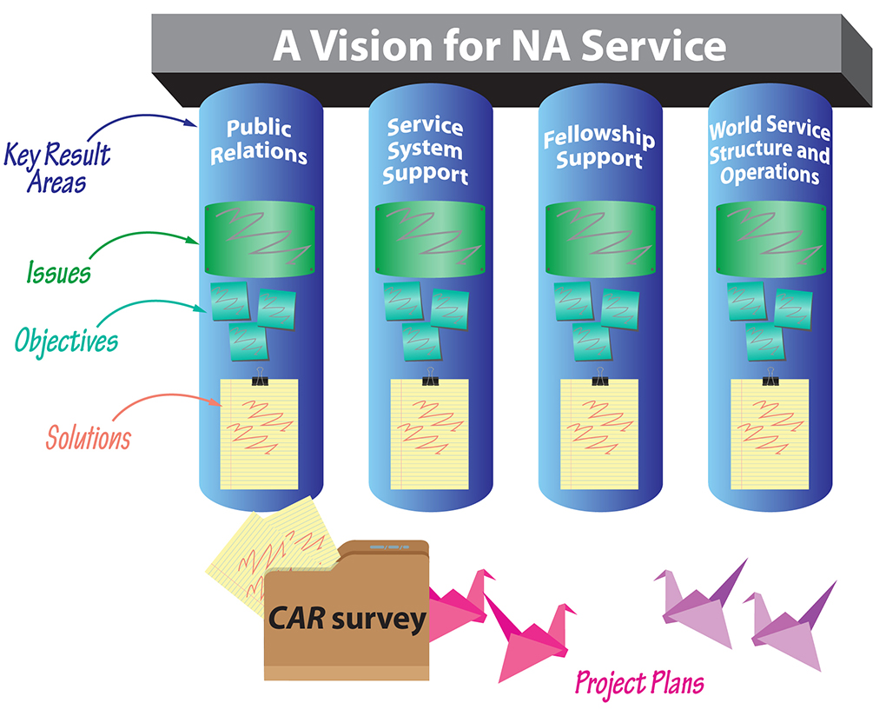
Notes:
Understanding the strategic plan means becoming familiar with the vocabulary. These are the components of the plan:
Key Results Areas are the major areas in which the service efforts are focused in order to realize A Vision for NA Service. These are the four pillars of the plan that are built together. They will change very little, if at all, from cycle to cycle.
Issues are the factors that conference participants collectively decided are most important to address this cycle.
Objectives are goals to aim for. They express what we want to achieve by the end of the planning cycle, as opposed to how we want to achieve it.
Solutions are paths to achieving our objectives. They are the work we want World Services to undertake on behalf of NA as a whole. Solutions don’t have to include everything that might make progress on an objective, just the steps we want to take in the cycle ahead, if the project is prioritized.

Slide 13
na.org/planning
計画策定プロセス
WSC 2023 カンファレンス参加者（CP）はインベントリーを開始しました。
WSC 2023後 CPはアンケートを通じて、それらの要因に優先順位を付けました。
2024年2月〜5月 世界のすべてのゾーンが会合を行い、要因によって提起された課題と考え得る解決策について話し合いました。
2024年6月 ワールドボード（WB）は、これらすべての議論メモに基づいて目的を草案化しました。
中間WSC CPは課題と目的について話し合いました。
2025年7月 WBは目的を修正し、解決策の草案を作成しました。
8月 CPウェブミーティング CPは解決策について話し合いました。
2025年9月 WBは解決策を修正し、計画の最終草案を確定しました。
Notes:
The extra time in the experimental three-year cycle allowed the conference to create this plan together. The planning section of the conference webpage contains reports on the progress from throughout the cycle: na.org/planning.
WSC 2023 Conference participants (CPs) began an inventory, identifying factors, inside and outside of NA, that could affect our ability to carry the message.
After WSC 2023 CPs prioritized those factors via survey.
February through May 2024 Every zone in the world met and discussed the challenges raised by the factors and possible solutions.
June 2024 World Board drafted objectives based on all those discussion notes and also drafted World Services Structure and Operations objectives.
Interim WSC Conference participants discussed issues and objectives.
July 2025 World Board revised objectives based on CP discussions at the Interim WSC. World Board drafted solutions.
August CP web meeting Conference participants discussed solutions.
September 2025 World Board revised solutions and finalized draft of plan based on CP discussions.

Slide 14

計画の実施
カンファレンス承認トラック（Conference Approval Track）の資料には、NAWS戦略計画から発展したプロジェクト計画が含まれています。
2016年以降、CARサーベイの結果は、いくつかの
プロジェクトにおける重点分野を選定するうえで、カンファレンス参加者
（CP）を導く指針となってきました。
計画プロセスを評価し、改善していくことは、WSC 2026で話し合われる多くのテーマのひとつです。ほとんどのプロジェクトは、フェローシップ全体へのサーベイ（調査）から始まります。フォーカスグループは、その作業を前に進めるための重要な役割を果たします。これからのサイクルにおいては、ゾーンやリージョンが極めて重要になります。
NAWS戦略計画が、各地でのローカルなプロジェクトを刺激し、後押しするものとなることが期待されています。
Notes:
The specifics of how to implement solutions are spelled out in project plans. The Conference Approval Track material contains the project plans that grow out of the NAWS Strategic Plan. Within the project plans in the Conference Approval Track material are “blank” plans for recovery literature, service material, and Issue Discussion Topics. Since 2016, the results from the CAR Survey have guided conference participants to help select focuses for these projects.
The conference is new to collaborative planning, and it will continue to refine the process. Evaluating and improving the planning process is one of the many things that will be discussed at WSC 2026.
Most projects for service material or recovery literature begin with some sort of Fellowship-wide survey to determine what members would like to see included or considered in the project. Then virtual focus groups are used to get the work done. Focus groups as opposed to standing workgroups are cheaper, more flexible and allow greater diversity. However, with the projects suggested in the cycle ahead, NAWS will also be asking zonal and regional bodies to work on the projects by holding workshops, collecting best practices, and reviewing drafts. Making progress on most of the solutions in the plan depends upon collaboration from zones and regions.
In fact, it is the hope that the NAWS Strategic Plan inspires local projects. There may be solutions that fit inside these objectives that can be addressed at local levels, and perhaps the plan will encourage more local service bodies to engage in their own planning.

Slide 15
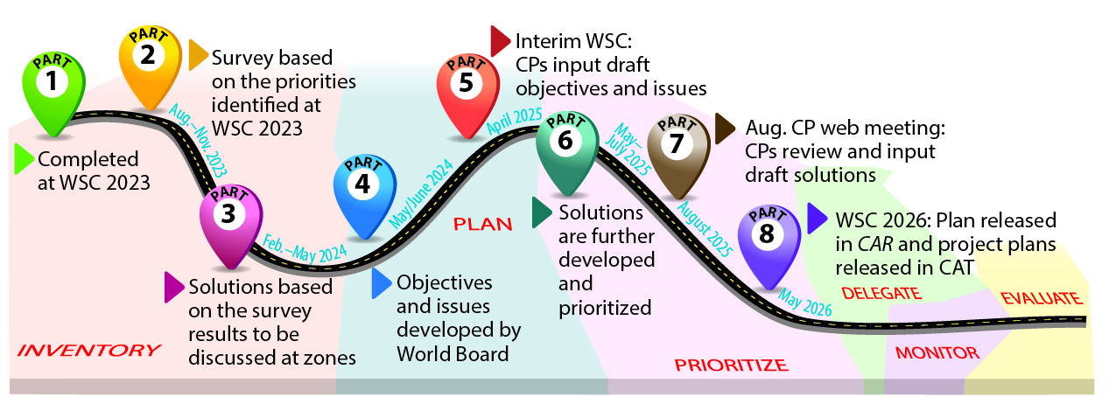
2026年のワールド・サービス・カンファレンス（WSC）では、デリゲートたちが次期戦略計画に向けた作業を開始することを求められます。
私たちは、今ここにいるアディクト、そしてこれから現れてくるアディクトにサービスを提供する準備を整えるために、どのような課題、挑戦、そしてニーズに取り組む必要があるのでしょうか。
Notes:
Throughout this cycle, the planning journey has been illustrated as a road trip we have been taking together, but in reality, the planning process is cyclical. Because planning is cyclical, the next strategic plan will be created as this one is approved. At the 2026 World Service Conference, delegates will be asked to start that work, just as they started the planning process in 2023 to get here today. Having fewer motions in the CAR means more time at WSC 2026 for discussions, and some of those discussions will center around the factors in NA and the world around us that may most affect NA in the years ahead (after 2029).
The question participants will discuss at the WSC may be something like this:
What issues, challenges, and needs do we need to address to be ready to serve the addict here today and who will be here in the future?
If that question sparks ideas for you, share them with your delegate or at your area or regional CAR workshop.
[Facilitator: If there is time, you may want to pause for discussion here.]

Slide 16
計画を採択すること
デリゲートたちは、今後3年間にワールドサービスが最も取り組む必要のある作業がこの計画にしっかりと示されるよう、（文字どおり）何年にもわたって協力してきました。この計画のすべての部分は、カンファレンス参加者――デリゲート、オルタネイト、そしてワールドボード――によって議論されてきました。
この計画を作り上げるために、実に数多くの話し合いが重ねられてきました。これはまさに、コンセンサスに基づくプロセスでした。
私たちは、皆さんの共通の福利のために、皆さんの代表であるデリゲートたちが共同で作り上げてきたこの計画を、フェローシップとして主体的に引き受けてほしいとお願いしています。
Notes:
The NAWS Strategic Plan is large and contains many details, but you’re being asked to adopt it as a whole, rather than piece by piece. The delegates worked together for years (literally) to make sure the plan outlines the work World Services most needs to undertake in the three years in front of us.
The plan absolutely reflects our collective needs and priorities. Every bit of the plan has been discussed by conference participants—delegates, alternates, and the board. There have been many, many discussions to create this plan. This has truly been a consensus-based process.
We are using the word adopt in the motion rather than approve because, while most members are seeing this for the first time, the plan has been created collectively over the course of years. We are asking the Fellowship to take ownership of something that your delegates have co-created on your behalf for our common welfare.

Slide 17
動議 2: 付録Bに含まれている、共同で作成された2026–2029年NAワールドサービス戦略計画を採択すること。
提案者：ワールドボード
意図：WSC 2023で始まり、このサイクル全体を通じてゾーンおよびカンファレンス参加者の関与のもとで継続されてきた、協働的な計画プロセスの成果を承認すること。
財政的影響：直接的な財政的影響はありません。
今後発生し得る費用については、
プロジェクト計画または予算の中で明示されます。
影響を受ける方針：なし
ここでディスカッション用の一時停止
Notes:
Motion 2: To adopt the collaboratively created 2026–2029 NA World Services Strategic Plan contained in Addendum B.
Maker: World Board
Intent: To approve the results of the collaborative planning that began at WSC 2023 and continued with zonal and conference participant involvement throughout this cycle.
Financial Impact: No direct financial impact. Any future expenses will be called out in project plans or budgets.
Policy Affected: None
pause for discussion

Slide 18
WCNA の歴史
1971年〜1996年：年次イベント
1990年代半ば：2年ごとの開催となり、隔回で北米以外で開催
1998年〜2009年：ローテーションに北米以外の開催地を2か所追加
2012年：2015年以降を起点として、3年ごとの開催とし、米国開催と米国外開催を交互に実施
Notes:
For over five decades, the World Convention has been a celebration of unity and recovery for the Fellowship. From 1971 to 1996, it was an annual event. In the mid-90s, the then World Convention Corporation presented motions, which were adopted by the WSC, to create a new “zonal” rotation plan and change to a two-year schedule. The goal of this rotation plan was to increase worldwide participation by moving the convention outside of North America every other convention. The rotation plan was then slightly altered, from nine zones to six, adding in two extra North American locations during the 1998 to 2009 timeframe.
Faced with ongoing challenges related to attendance, effective planning, and the financial bottom line, the World Board proposed a new rotation plan that was adopted at WSC 2012. This revised plan would alternate between US and non-US locations, with the convention being held every three years beginning in 2015.

Slide 19
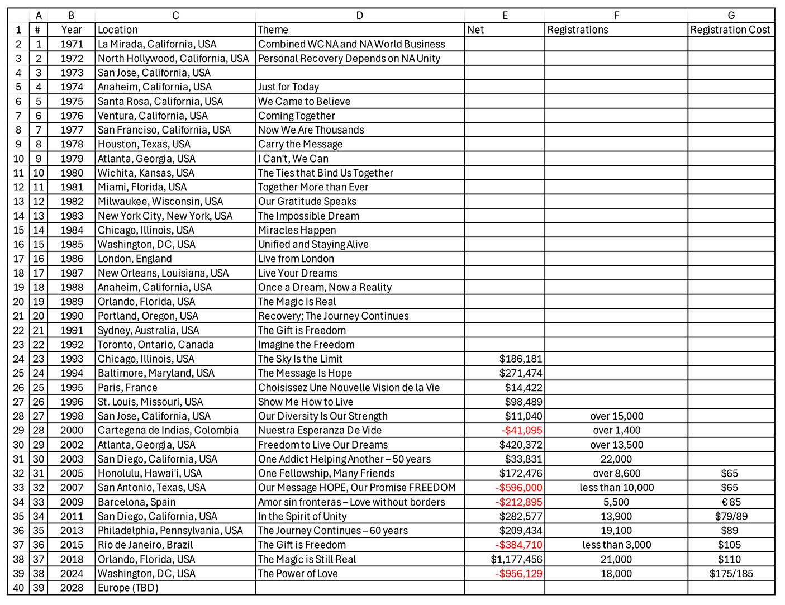
na.org/wcna
WCNA の歴史
2023年：2024年以降のWCNAローテーション・ポリシーを一時停止し、今後に向けて何が可能で実際的かを調査・検討するための時間を確保することとした
Notes:
With the exception of WCNA 32 in San Antonio, the trend for conventions held in North America was positive. Both WCNA 34 and 35 had good attendance and modest profits. The magic of WCNA 37 (Orlando), in 2018, was outstanding. That convention saw more than 21,000 in attendance and a substantial income of over a million dollars. This was largely due to the beneficial contract for meeting space and the level of attendance.
Prior to the global pandemic in 2020, WCNA 38 was planned to be held in Melbourne, Australia. After the global shutdown, travel and health concerns from COVID, entwined with the strain on financial and human resources of NA World Services, made canceling the convention the most responsible action.
In response to unstable circumstances, the 2023 WSC approved a motion offered by the World Board to suspend the WCNA rotation policy after 2024, to allow time to research and determine what is possible and practical moving forward with the World Convention.
For more information on the history of WCNA please go to na.org/wcna.

Slide 20
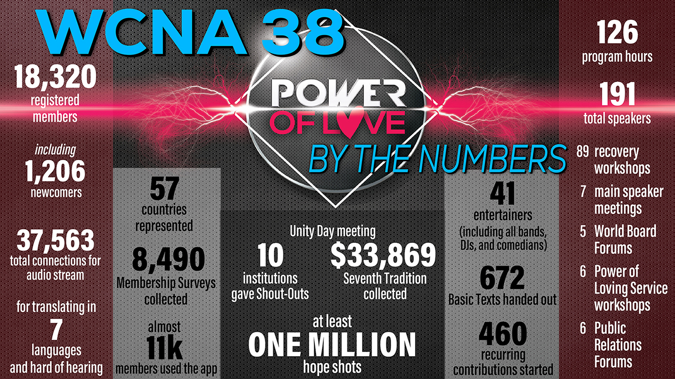
Notes:
WCNA 38 was held in 2024 in Washington, DC. One of the main things WCNA 38 taught us was just how much the landscape had changed and how uncertain convention attendance could be. Based on the trends from the past two conventions in North America, the fact that there had not been a WCNA in six years, and that Washington, DC, is located within an easy drive of many of the most densely populated NA regions, it was reasonable to think that attendance had the potential to be even higher than in Orlando, and it made logical sense to plan accordingly. In most cases, past performance can be indicative of future outcomes, but that was not the case here, as we now know.
In addition to financial strain in the current economy, other factors, such as lingering health and safety concerns, especially among our aging members, may have also contributed to the overall level of attendance in DC. WCNA 38 was planned for a projected attendance of 24,000, and just over 18,000 members registered.

Slide 21
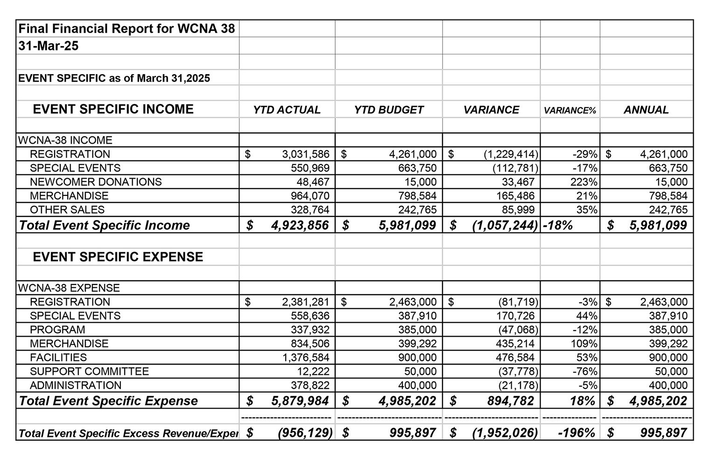
WCNA 会計報告
from 2024 Annual Report na.org/ar
Notes:
As was reported in the 2024 Annual Report, the bottom line for WCNA 38 reflects expenses over income of $956,129. Thankfully, World Services’ efforts to increase reserves helped us to be prepared for an unfavorable outcome.

Slide 22
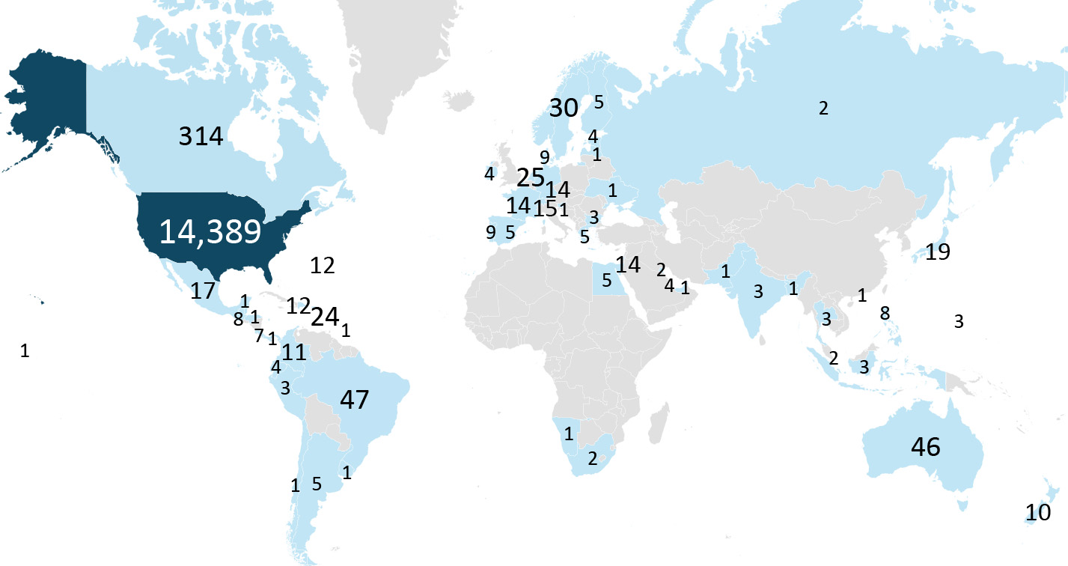
回答した3,616人のうち大多数が、参加するかどうかの判断に最も大きな影響を与える要因として、渡航費用やその他の経済的要因、そして開催地を挙げた。
WCNA 38 pre-registrations by country
Notes:
The 2023 motion to suspend the current rotation policy of WCNA gave World Services time to research and evaluate what would be practical moving forward. It took most of the past 18 months to gather the information needed for the discussions and to reach consensus on what changes in policy made the most sense.
A survey was conducted to see if there was a common theme of why NA members attend (or don’t attend) WCNA. As expected, the majority of the 3,616 responding ranked costs of travel and other financial factors, as well as location, as the highest influencers on their decision of whether to attend. Nearly half of the responses received were from members who have never attended a WCNA. There will be more on the results from this survey reported in the Conference Report prior to WSC 2026.

Slide 23

これから
多くの要因が、ワールドボードが動議3を提案するという判断に至る背景となりました。全体的な費用、市場動向、国際移動に伴うコストや複雑さ、世界的な政治・経済状況などです。
提案されているガイドラインでは、不確定要素
があまりにも多いため、ローテーションや
開催地の決定に関する責任のより多くを
ワールドボードに委ねる内容となっています。
さらなる洞察については
CARに掲載されているエッセイをお読みください。
Notes:
Many factors brought the World Board to their decision to offer Motion 3: Overall expenses, market trends, costs and complexities of international travel, global political and economic climates, etc.
The proposed guidelines delegate more of the rotation and location decision-making responsibility to the World Board simply because so much is unknown—inside and outside of NA. The conference industry as a whole is changing; our members’ behavior is changing; and there is no way to predict what the landscape will look like years in the future.
Please read the essay in the CAR for more insights.

Slide 24
動議3： 2028年以降、ナルコティクス・アノニマス・ワールド・コンベンション（WCNA）を5年ごとに開催すること。開催地は、少なくとも収支が均衡するイベントとなるよう、財政的および地理的な観点を考慮してワールドボードが決定するものとする。 （GWSNAにおけるWCNAガイドラインへの具体的な変更は、付録Cに示されている。）
提出者： ワールドボード
Notes:
Motion 3: To hold the World Convention of Narcotics Anonymous (WCNA) every 5 years, beginning in 2028. The location to be determined by the World Board based on fiscal and geographic considerations that lend themselves to, at minimum, a revenue neutral event. (The specific changes to the WCNA Guidelines in GWSNA are shown in Addendum C.)
Maker: World Board

Slide 25
動議 3:
意図： 世界的に大規模イベントの性質が変化している現状を反映し、フェローシップの資源を慎重に用いることを支える、ワールド・コンベンション（WCNA）のためのガイドラインを設けること。
財政的影響： 直接的な財政的影響はない。将来発生する可能性のある費用については、プロジェクト計画または予算の中で明示される。
影響を受ける方針： 付録Cで提示されている方針は、付録Dに示されている
GWSNA（46～48ページ）内の現行のWCNAガイドライン
に取って代わる。
ここでディスカッション用の一時停止
Notes:
Intent: To have guidelines for the World Convention (WCNA) that reflect the changing nature of large events worldwide and support the prudent use of Fellowship resources.
Financial Impact: No direct financial impact. Any future expenses will be called out in project plans or budgets.
Policy Affected: The policy offered in Addendum C will replace the current WCNA guidelines in GWSNA (pages 46–48) shown in Addendum D.
pause for discussion

Slide 26
リージョンからの動議
検討および決定のための動議が少なくなることで、WSCの場において、カンファレンス参加者がNA全体に影響を与える課題について話し合うための時間がより多く確保される。また、協働的な計画プロセスにおける次のステップを練り上げ、形づくっていくための時間も確保される。
Notes:
Regional Motions
Having two motions from regions in this CAR is definitely not the norm for the WSC, but perhaps it’s a sign of the shift toward a more collaborative and discussion-based conference. With fewer motions for discussion and decision there will be more time during the WSC for conference participants to talk about issues that affect NA as a whole; and time to work on honing and shaping the next steps in the collaborative planning efforts.

Slide 27
リージョン/ゾーン からの動議のプロセス
2025年7月1日：CAR動議ドラフト提出期限 2025年8月3日：最終ドラフト提出期限
動議ドラフトは9本提出された。 そのうち、カンファレンスでの対応を必要としないいくつかの合意が得られた。これらはCARの44ページに記載されている。 動議ドラフトのうち2つのアイデアは、すでにCARサーベイの項目で扱われていた。 最終的に、このCARに含まれるリージョン動議は2本となった。
Notes:
The deadline to submit a draft motion to the CAR was July 1st 2025, with the final draft by August 3rd 2025. As of July 1st, there were nine draft motions submitted. Over the course of the month, the board worked with the motion makers to help them get the motions “CAR-ready.” A Guide to World Services explains what makes a motion “CAR-ready” on pages 19–20.
The World Board often reaches solutions with motion makers that do not require conference action. Several such agreements were reached. These are described on page 44 of the CAR. These agreements are great examples of ways to collaborate with the World Board. Often ideas or concerns can be resolved without the need for a CAR motion. The World Board always encourages concerned members to reach out, via email to wb@na.org, to start a conver¬sation.
In two other cases, the ideas contained in draft motions were already covered by items contained within the CAR Survey, The Interim WSC had passed a motion to include all ideas for new and revised recovery literature and service material in the CAR Survey rather than as CAR motions for the 2026 conference as an experiment, so the ideas could be considered and prioritized next to each other.
The end result is the two regional motions currently in this CAR.

Slide 28
動議4：
すでに受刑者用タブレットで提供されているIPおよび第5版ベーシックテキストの音声版に加えて、受刑中のアディクトに対して書籍長の文献をタブレットで提供することの可能性と障害を調査・検討するため、WSC 2029で検討されるプロジェクト計画を作成するようワールドボードに指示すること。
提出者： アリゾナ・リージョン 共同提出者： フロリダ、オハイオ、北カリフォルニア、南カリフォルニア、スウェーデン、UK、ユタ
Notes:
Motion 4: To direct the World Board to create a project plan for consideration at WSC 2029 to research and explore the opportunities and obstacles of providing booklength pieces of literature to the incarcerated, on tablets, in addition to the IPs and audio version of the Fifth Edition Basic Text that already exist on inmate tablets.
Maker: Arizona Region
Co-makers: Florida, Ohio, Northern California, Southern California, Sweden, UK, Utah

Slide 29
動議 4:
意図： 受刑中のアディクトに対して、書籍長の文献をタブレットで提供することに関する可能性と障害について、カンファレンスおよびフェローシップが実質的な議論を行えるようにするため。
財政的影響： プロジェクト計画の作成自体にかかる費用は最小限である。WSCが当該計画を採択し、優先事項とした場合にのみ、プロジェクトそのものに関してNAWSに費用が発生する。
影響を受ける方針： なし
Notes:
Intent: To give the Conference and Fellowship the ability to meaningfully discuss the opportunities and obstacles of making booklength pieces of literature available to the incarcerated on tablets.
Financial Impact: There is minimal cost in creating a project plan. The cost to NAWS would be in the project itself if the WSC were to adopt and prioritize the plan.
Policy Affected: None

Slide 30
動議 4—リージョンによる説明
ナルコティクス・アノニマスは、回復を求めるすべてのアディクトに、希望と自由のメッセージを運ぶために存在しており、それには塀の内側にいるメンバーも含まれます。矯正制度が物理的な書籍から安全なデジタル・タブレットへとますます移行する中で、多くの被収監アディクトは、『今日だけ』、『なぜ、どのように効果があるのか』、『リビング・クリーン』といった書籍サイズのNA文献へのアクセスを断たれつつあります。何の対応もしなければ、この変化は、最も孤立したメンバーの一部にとって、私たちのメッセージの基盤へのアクセスを制限してしまうおそれがあります。…
Notes:
Rationale by Region: Narcotics Anonymous exists to carry a message of hope and freedom to every addict seeking recovery, including our members behind the walls. As correctional systems increasingly transition from physical books to secure digital tablets, many incarcerated addicts are being cut off from booklength NA literature such as Just for Today, It Works: How and Why, and Living Clean. Without action, this shift threatens to limit access to the foundation of our message for some of our most isolated members. ...

Slide 31
動議 4—リージョンによる説明
この動議が承認されれば、ワールドボードは、刑務所のタブレット・システムを通じてフェローシップの書籍サイズの文献を提供するための、実際的かつ原則に基づいた方法を検討するプロジェクト計画を策定できるようになります。この計画では、フェローシップ知的財産トラスト（FIPT）に定められているとおり、自立の原則を守り、NAの知的財産の完全性を維持することを確保しつつ、物流面、法的側面、財政面、そしてフェローシップに関わる課題が検討されます。
すでに多くの被収監メンバーは、施設の方針や地理的条件によって、文献へのアクセスに格差を抱えています。…
Notes:
Approving this motion would allow the World Board to develop a project plan exploring practical, principled ways to make our Fellowship’s booklength literature available through prison tablet sys-tems. This plan would examine logistical, legal, financial, and Fellowship-related issues, ensuring that any approach upholds the principles of self-support and preserves the integrity of NA’s intellectual property, as outlined in the Fellowship Intellectual Property Trust (FIPT).
Many incarcerated members already face disparities in literature access, depending on facility pol¬icies and geography. ...

Slide 32
動議 4—リージョンによる説明
デジタルでの提供という選択肢を探ることは、変化する環境に適応しつつ、こうした不平等にフェローシップとして対応する助けとなります。また、矯正施設との信頼に基づくトラステッドサーバントとしての関係を強化し、経済的に限られた状況にある人々にもNA文献が引き続き届くようにする機会ともなります。
この動議を支持することで、ワールド・サービス・カンファレンスは、状況のいかんにかかわらずすべてのアディクトにメッセージを運ぶという私たちのコミットメントを再確認することになります。そして、フェローシップによる検討と承認に向けて、十分な情報に基づいた選択肢を持ち帰るために、ワールドボードが主体的に取り組むことを後押しすることになります。
Notes:
Exploring digital options would help the Fellowship respond to these inequities while adapting to a changing environment. It also presents an opportunity to strengthen our trusted servant relationships with correctional institutions, ensuring that NA literature remains accessible to those with limited financial resources.
By supporting this motion, the World Service Conference would affirm our commitment to carrying the message to all addicts, regardless of circumstance, and empower the World Board to be proactive, bringing back informed options for Fellowship review and approval.

Slide 33
動議 4—ワールドボードの見解
ワールドボードは、被収監者を含むすべてのアディクトがNA文献および回復のメッセージにアクセスできるようにするという、動議提出者のコミットメントを共有しています。私たちは、矯正制度において印刷された書籍からデジタル・タブレットへと移行していることが、機会と課題の両方をもたらしていることを認識しています。
しかし、NAワールドサービスはすでに、自立の原則およびフェローシップ知的財産トラスト（FIPT）の完全性を守りながら、矯正施設における文献アクセスを確保するための継続的な取り組みを行っているため、この動議は不要であると私たちは考えています。現在、私たちはベンダーや関係部門と協力し、na.orgですでに利用可能な資料を、無償で提供しています。…
Notes:
World Board Response: The World Board shares the maker’s commitment to ensuring that all addicts—including those who are incarcerated—have access to NA literature and the message of recovery. We recognize the shift from printed books to digital tablets in correctional systems offers both opportunities and challenges.
We believe this motion is unnecessary, as NA World Services is already engaged in ongoing efforts to make literature accessible in correctional facilities while upholding self-sup¬port and the integrity of the Fellowship Intellectual Property Trust (FIPT). We currently work with vendors and departments to provide, at no cost, materials already available on na.org. ...

Slide 34
動議 4—ワールドボードの見解
ベーシックテキストは、音声版として12言語で利用可能であり、IP、小冊子、翻訳資料は61言語でアクセスできます。また、10本のIPとベーシックテキストの「ステップ」の章を含む『NA入門ガイド』は、まもなく英語およびスペイン語の音声版で提供される予定です。
タブレットで全文書籍を提供することは、単純な解決策ではありません。矯正環境は施設ごとに大きく異なり、現在も多くの施設では紙の書籍が求められています。私たちは、無償で提供している資料に対して料金を課す営利目的のタブレット企業とは契約していません。私たちの焦点は商業化ではなく、アクセスの確保にあります。…
Notes:
The Basic Text is available in twelve languages in audio, and IPs, booklets, and translated materials are accessible in 61 languages. An Introductory Guide to NA—with ten IPs and the Steps chapter from the Basic Text—is soon to be avail¬able in English and Spanish audio.
Providing full-length books on tablets is not a simple solution. Correctional environments vary widely; many still require physical books. We do not contract with for-profit tablet companies that would charge for materials we provide for free. Our focus remains on accessibility, not commercialization. ...

Slide 35
動議 4—ワールドボードの見解
NAワールドサービスは、現在も主に文書販売によって資金が賄われており、その相当な部分は、収監されているアディクトを支援する取り組みから生まれていることを認識しておくことが重要です。私たちは使命を深く信じているからこそ、多くのリソースを無償で提供していますが、同時に、そのメッセージを世界中に届け続けることを可能にしているサービスの持続可能性も確保しなければなりません。
かつて私たちは主要な文書のPDF版をオンラインで提供していましたが、大規模な無断配布が発生したため、提供を中止せざるを得ませんでした。現在では、特にスペイン語の音声資料が、受刑者用タブレットにおいて最も頻繁に利用されているリソースとなっています。こうした状況が、近年の録音プロジェクトの方向性を導いてきました。…
Notes:
It is important to recognize that NA World Services remains largely funded through literature sales, a considerable amount of which comes from initiatives to help incarcerated addicts. We make many resources freely available because we believe deeply in our mission; we must also ensure the sustainability of the services that allow us to carry that message worldwide.
We once offered PDFs of major titles online, but massive unauthorized distribution forced their removal. Audio materials, especially in Spanish, are now the most frequently accessed resources on inmate tablets. This has guided our recent recording projects. ...

Slide 36
動議 4—ワールドボードの見解
20年以上にわたるこれまでの慣行どおり、NAワールドサービスは、要請に応じて収監されているメンバーに無償で文書を提供し、継続的な関わりの後にはベーシックテキストを提供し続けています。私たちはまた、施設内にミーティングを届けるH&Iの取り組みや、再入所支援の重要性、さらに依存症治療薬を受けているメンバーがNAで歓迎されていると感じられるよう支援することの重要性も認識しています。
デジタルツールは今後も進化し続けますが、テクノロジー、人と人とのつながり、そして財政的責任を組み合わせた私たちのバランスの取れたアプローチこそが、メッセージを伝えるうえで最も効果的な方法
であり続けています。この動議の意図は、すでにNA
ワールドサービスで進行中の取り組みと一致しています。
ここでディスカッション用の一時停止
Notes:
As has been our practice for more than two decades, NAWS continues to provide free literature to incarcerated members upon request and offers a Basic Text after continued contact. We also recognize the importance of H&I efforts to carry meetings into facilities as well as reentry support, including helping members who receive addiction medication to feel welcome in NA.
While digital tools will continue to evolve, our balanced approach—combining technology, human connection, and financial responsibility—remains the most effective way to carry our message. The motion’s intent aligns with work already in progress at NA World Services.
pause for discussion

Slide 37
動議5：
WSCのミーティング（対面およびバーチャルの両方）において、現在行われている人によるライブ通訳に代えて、人工知能（AI）による通訳ソリューションを導入するよう、ワールドボードに指示する。
提出者： サウス・フロリダ・リージョン
共同提出者： イラン、UK、ネパール
Notes:
Motion 5: To direct the World Board, to implement artificial intelligence (AI) interpretation solutions for WSC meetings (both in-person and virtual) to replace the current human live language interpretation.
Maker: South Florida Region
Co-makers: Iran, UK, Nepal

Slide 38
動議 5:
意図： 言語の壁を取り除き、世界中ですべての声が確実に聞かれるようにすることで、ビジネスミーティングにおけるコミュニケーションと時間効率を向上させること。また、この取り組みは、人による通訳に伴う誤訳のリスクや、セッション中に通訳者が不在となる可能性を減らすことも目的としている。
財政的影響： この技術を導入することによる財政的影響は大きくなると見込まれるが、さらなる分析が必要であり、現時点ではまだ確定していない。
影響を受ける方針： なし
Notes:
Intent: To eliminate language barriers, ensuring that all voices are heard globally, enhancing our communication and time efficiency during business meetings. This initiative also aims to reduce the risk of human interpretation errors and potential absences during our sessions.
Financial Impact: The financial impact of implementing this technology is expected to be significant but has not yet been determined pending further analysis.
Policy Affected: None

Slide 39
動議 5—リージョンによる説明
この取り組みの意図について、さらに明確にしたいと考えています。私たちの目的は、第一言語が英語ではないRDおよびADが、直接的な議論の場において自分の母語でより効果的に意見を表明できるようにすることです。これにより、通訳への依存を減らすことができます。
また、このアプローチは第二のコンセプトとも整合しています。すなわち、サービス構造は、霊的導きを含め、グループからの指針とリソースを求めるというものであり、私たちはこの文脈において、これを良心の問題として捉えています。
Notes:
Rationale by Region: We would like to provide further clarification regarding the intent of this initiative. Our objective is to empower RDs and ADs whose primary language is not English, enabling them to articulate their perspectives more effectively in their native language during direct discussions. This will reduce the reliance on interpreters. Additionally, this approach aligns with our second concept: the service structure will seek guidance and resources from the groups, including spiritual guidance, which we regard as a matter of conscience in this context.

Slide 40
動議 5—ワールドボードの見解
ワールドサービスは、特に第一言語が英語ではないメンバーにとって、ワールドサービスカンファレンス（WSC）におけるコミュニケーションと参加を向上させるという目標を共有しています。参加への障壁を取り除くことは、私たちが非常に大切にしていることです。
しかし、この動議は、カンファレンスが状況に応じて適応し、適時に運営上の判断を行う能力を制限してしまうことになります。私たちは、アクセシビリティと効率性を高めるために新しいテクノロジーを試行することには賛成です。けれども、この動議は、人による通訳に代えてAI通訳を用いるという特定の手段を義務づけている点に問題があります。懸念されているのは、まさにその「置き換え」です。
Notes:
World Board Response: World Services shares the goal of improving communication and participation at the World Service Conference (WSC), especially for members whose first language is not English. Removing barriers to participation is something we deeply value.
However, this motion would limit the conference’s ability to adapt and make timely operational decisions. We support experimenting with new technologies to enhance accessibility and efficiency, but this motion mandates a specific tool—AI interpretation—to replace human interpreters. That replacement is the concern. ...

Slide 41
動議 5—ワールドボードの見解
人による通訳者は、ほぼ例外なくNAのメンバーであり、正確さ、文化的な理解、そしてテクノロジーでは再現できないスピリチュアルなつながりをもたらしています。彼らを置き換えることは、WSCにおける効果的なコミュニケーションを損なうことになります。
私たちは長年にわたり、WSCの参加者自身こそが、プロセスの変更を試し、判断するのに最も適した立場にあると考えてきました。これは、2023年のCARに対する私たちの回答にも次のように示されています。 「WSCミーティングに影響を与えるプロセスについて、参加者が意思決定できるようにすることは、こうした変更をCARを通じて行うよりも、はるかに機動的である。」
テクノロジーが急速に進化していることを考えると、固定的な方針よりも柔軟性のほうが、より実用的であると言えます。
Notes:
Human interpreters, nearly always NA members, bring accuracy, cultural understanding, and a spiritual connection that technology cannot replicate. Replacing them would undermine effective communication at the WSC.
We’ve long held that WSC participants themselves are best positioned to test and decide on process changes, as noted in our 2023 CAR response: “Allowing participants to make decisions about the processes that affect the WSC meeting is significantly more nimble than making these types of changes through the CAR.” Given how quickly technology evolves, flexibility is more practical than a rigid policy. ...

Slide 42
動議 5—ワールドボードの見解
AIツールは、代替としてではなく補完として、より小規模な場やカンファレンスとカンファレンスの間で検討される可能性はあります。しかし、試験的導入や調査も行わないまま、現時点でそれらを義務化するのは時期尚早です。
WSCの通訳者は、単に言葉を翻訳しているのではありません。回復の概念、感情のトーン、文化的なニュアンスといった、相互理解に不可欠な要素を伝えています。また、セッションとセッションの間でも参加者を支援し、AIではまだ提供できない双方向のコミュニケーションを確保しています。
カンファレンスでの議論には、時に機微な内容が含まれます。AIを用いたシステムには、プライバシー上の潜在的なリスクがあり、また人による通訳者が持っているNAのトラディションに対する理解を欠いています。
Notes:
AI tools could be explored as supplements—not replacements—in smaller settings or between con-ferences, but mandating them now, without trials or research, is premature. WSC interpreters do far more than translate—they convey recovery concepts, emotional tones, and cultural nuances vital to understanding. They also help participants between sessions, ensuring two-way communication that AI cannot yet provide.
Conference discussions sometimes include sensitive matters. AI-based systems pose potential pri¬vacy risks and lack the understanding of NA’s Traditions that human interpreters bring. ...

Slide 43
動議 5—ワールドボードの見解
現在のテクノロジーは、正確さ、速度、文脈理解の面でも課題を抱えており、特に私たちの回復に特有の専門用語や表現に関しては十分とは言えません。
ワールドボードは、コミュニケーションを支援するための新しいツールを継続的に探求していくことを支持していますが、人による通訳を置き換えるものとして義務化することには賛成していません。
WSCの成功は、柔軟性、包括性、そしてスピリチュアルなつながりにかかっており、自動化そのものに依存するものではありません。
テクノロジーが進化し続ける中で、カンファレンスの場におけ
る継続的な試行と対話を促していきたいと考えています。
ここでディスカッション用の一時停止
Notes:
Current tech¬nology also struggles with accuracy, speed, and context—especially with our specialized recovery language.
The World Board supports continued exploration of new tools to aid communication, but not as mandated substitutes for human interpreters. The WSC’s success depends on flexibility, inclusivity, and spiritual connection—not automation. We encourage ongoing experimentation and dialogue at the conference level as technology continues to evolve.
pause for discussion

Slide 44
Five other PowerPoints available online
CAR survey available online
CAR available for download
worldboard@na.org
na.org/conference
Notes:
We hope this PowerPoint has helped in your discussion of this material. Please note that there are five other PowerPoints that focus on the rest of the CAR. These resources, the CAR itself, and the online CAR survey are available online at na.org/conference.
We welcome your questions and your feedback on the CAR, and all other issues, at worldboard@na.org.

