Slide 1

This is the fourth of seven PowerPoints covering material
in the 2023
Conference Agenda Report
CAR Survey
Notes:
This is the fourth of seven PowerPoints covering material in the 2023 Conference Agenda Report (or CAR for short).
2023 Conference Agenda Report（略称：CAR）』の内容を紹介する7つのパワーポイントの4つ目です。

Slide 2
2023 CAR
PowerPoints
1. Introduction to CAR : Creating Our Future,
Fellowship Intellectual Property Trust (Motions 1–3)
2. Virtual meetings (Motion 4), Vision for NA Service (Motion 5), Basic Text (Motion 6),
WB terms (Motion 7), WCNA (Motion 8)
3. Future of the WSC (Motions 9–12)
4. CAR Survey
5. Regional Motions 13–18
Regional Motions 19–25
Human Resource Panel Report
Notes:
This PowerPoint covers the Literature, Service Material, and Issue Discussion Topic survey.
このパワーポイントは、「文献」「サービス資料」「課題討議テーマ」のアンケートを対象としています。

Slide 3
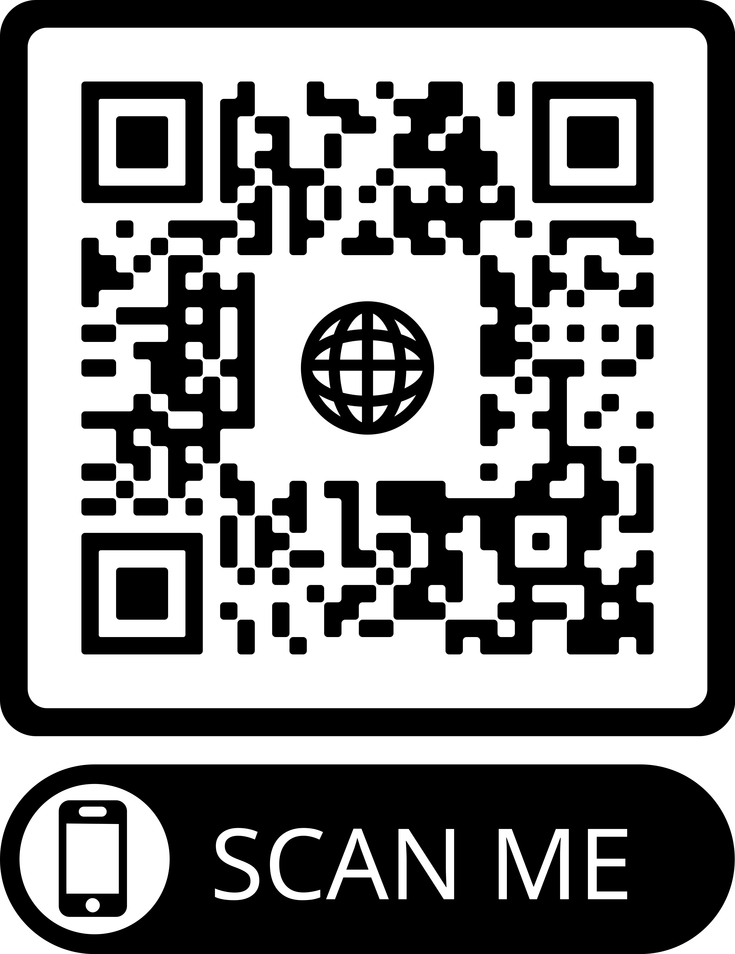
2023 CAR
PowerPoints
These PowerPoints only cover the main points of the CAR.
We encourage all members to read the CAR itself.
Please visit www.na.org/conference
for the complete 2023 CAR.
Notes:
Please keep in mind, these PowerPoints only cover the main points of the CAR. We encourage all members to read the CAR itself. Please visit www.na.org/conference for the complete 2023 CAR, the other PowerPoints, and other conference materials.
これらのパワーポイントは、CARの主要なポイントをカバーしているに過ぎないことに留意してください。会員の皆様には、CAR 自体をお読みになることをお勧めします。2023 年の CAR の全文、その他のパワーポイント、およびその他の会議資料については、www.na.org/conference をご覧ください。

Slide 4
CAR Survey
Please see the CAR introduction, particularly pages 4 through 6, for more detail.
Opening essay of the CAR provides some background about the resource challenges the pandemic created for NAWS and the role of CAR survey in trying to unite two streams of ideas for projects.
Notes:
The opening essay of the CAR provides some background about the resource challenges the pandemic created for NA World Services and the role of the CAR survey in trying to unite two streams of ideas for projects: World Services’ strategic planning process and CAR motions. Despite achieving more than we imagined possible with fewer resources than we’ve had in decades, World Services is still facing a considerable backlog of work. The results of the CAR survey help the conference select Issue Discussion Topics and prioritize literature and service material projects to work on in the cycle ahead. This prioritization process is important because there are more good ideas than there are resources to accomplish the work.
CARの冒頭のエッセイでは、
１）パンデミックがNAワールドサービスにもたらしたリソースの課題についての背景と
２）NAWSの戦略的計画立案プロセスとCAR動議という2つのアイデアの流れを統合しようとするCARアンケートの役割について述べています。
ここ数十年来の少ない資源を基に想像以上の成果を上げているにもかかわらず、世界サービスはまだかなりの仕事の滞留に直面している。CAR調査の結果は、大会が課題討議テーマ（IDT）を選択し、今後のサイクルで取り組むべき文献やサービス資料のプロジェクトに優先順位をつけるのに役立ちます。この優先順位付けのプロセスが重要なのは、（動議に含まれる）良いアイディアの方が、それを達成するために必要とされる財源・人材よりも多いです。
Please see the CAR introduction, particularly pages 4 through 6, for more detail.
詳しくは、CARの紹介文、特にP4～P6をご覧ください。

Slide 5
What is in the survey?
Four items in the survey come from regional motions the WSC has already approved
Most of the remaining ideas are carryovers from previous surveys
Also included are ideas from regional and zonal motions in this CAR
And ideas found through the planning process.
Notes:
This is the fourth time we are including a survey in the CAR. Four of the items in this survey come from regional motions the WSC has already approved to create project plans, and those are shown in blue with an asterisk after the title. The date in parentheses after these items is the year the motion was passed.
CAR にアンケートを掲載するのは、今回で 4 回目となります。このアンケートのうち4つの項目は、WSCがすでにプロジェクト計画作成を承認したリージョンの動議を基にした項目で、タイトルの後にアスタリスクをつけて青色で表示されています。これらの項目の後の括弧内の日付は、その動議が可決された年です。
Most of the remaining ideas are carryovers from the previous three surveys. We have also included the applicable ideas contained in regional and zonal motions in the 2023 CAR as well as ideas we have heard since the last conference through conversations, emails and phone calls, workshops, and input to the planning process.
残りのアイデアのほとんどは、過去 3 回のアンケートから引き継いだものです。また、2023年版CARのリージョン・ゾーンからの動議に含まれる適応可能なアイデアや、前回の会議以降に会話、電子メール、電話、ワークショップ、計画プロセスへの意見など提供されたアイデアも含まれています。
The survey keeps getting longer and longer, and it can be a bit overwhelming. To keep the size of the lists practical, the board tried to group similar ideas, and eliminated some items from previous CAR surveys that had a very low selection rate.
アンケートはどんどん長くなり、少し圧倒されることもあります。アンケートの量を実用的なものにするため、理事会は類似したアイデアを一つのグループにまとめ、過去のCAR調査の中から選択率が非常に低い項目を削除するように努めました。
After compiling all of the ideas, the board distributed a draft of this survey to conference participants for input, and then incorporated their ideas for changes where possible. Some participants suggested they would like to see an even more abbreviated list of choices, and perhaps in the future we will have a process for participants to collaboratively vet the CAR survey lists.
すべてのアイデアをまとめた後、理事会はこのアンケートのドラフト（草案）を会議参加者に配布して意見を求め、可能な限り参加者のアイデアを取り入れて変更を加えました。参加者の中には、さらに省略した選択肢のリストが欲しいという意見もあり、おそらく将来的には、参加者がCARの調査リストを共同で吟味するプロセスを設けることになると思います。

Slide 6

Survey Availability
NAメンバーは、2023年4月1日までに、www.na.org/survey に掲載されているオンライン版のアンケートに回答することができます。また、理事会は、大会参加者にも、日本時間4月2日午後3時59分までに、リージョンやゾーンからの決議・答えを提出するよう求めています。アンケートの結果はすべて、会議で検討するためにまとめられ、WSCの議事録に含まれる予定です。
Everyone has until 1 April to fill out the survey online at: www.na.org/survey
Notes:
Members can fill in the online version of the survey posted at www.na.org/survey by the first of April, 2023. The board is also asking conference participants to submit the conscience of their regions and zones by that same date. All of the survey results will be compiled for the conference to consider and included in the WSC minutes.
NAメンバーは、2023年4月1日までに、www.na.org/survey に掲載されているオンライン版のアンケートに回答することができます。また、理事会は、大会参加者にも、日本時間4月2日午後3時59分までに、リージョンやゾーンからの決議・答えを提出するよう求めています。アンケートの結果はすべて、会議で検討するためにまとめられ、WSCの議事録に含まれる予定です。

Slide 7

RECOVERY LITERATURE
Unless otherwise directed at the WSC, work will continue on The Loner IP revisions
“DRT/MAT as it relates to NA—what do we want to say in a piece of NA literature?” was an IDT last cycle
This section of the survey will help the WSC decide on future literature projects
Notes:
Unless otherwise directed by WSC 2023, the board is planning to continue work on finalizing revisions to The Loner IP, which was a project passed in 2020. Members were clear in their responses to the Loner survey about what they would like to see changed or included.
WSC2023から特に指示がない限り、理事会は2020年に可決されたプロジェクトであるThe Loner IPの改訂仕上げの作業を継続する予定である。Lonerのアンケートのメンバーからの回答によると、変更してほしいこと、盛り込んでほしいことが何かは明白だった。
We have also surveyed the Fellowship about their ideas for material to be in an IP about drug replacement therapy/medication-assisted treatment (DRT/MAT) as it relates to NA. WSC 2018 approved a motion to create a project plan to create that IP, and the 2020 WSC approved the idea for a survey and to accept “DRT/MAT as it relates to NA—what do we want to say in a piece of NA literature?” as the first Issue Discussion Topic for the cycle.
また、NAに関連する薬物置換療法／服薬支援療法（DRT/MAT）に関するIPに入れる資料のアイデアについて、フェローシップにアンケートを取りました。WSC2018では、そのIPを作成するためのプロジェクト計画を作成する動議が承認され、WSC2020では、
１）アンケートを取るというアイデアと、
２）「NAに関連するDRT/MAT-NAの文献の中で何を伝えたいか」をサイクルの最初のイシューディスカッショントピックとして受け入れることが承認されました。
The results of both surveys will be included in the Conference Report.
両アンケートの結果は、会議報告書に記載される予定です。
The Recovery Literature section of the survey will help the WSC set possible priorities for future work/project plans
アンケートの中のリカバリー文献のセクションは、WSCが今後の作業/プロジェクト計画の優先順位を決めるのに役立ちます。

Slide 8
NEW LITERATURE TO SUPPORT STEPWORK
Booklet of Step study questions taken from Chapter Four, “How It Works,” in the Basic Text
Step working booklet focused mainly on Steps 1–3, aimed primarily at new members and those in treatment and drug courts
Step working guide aimed at members not new to working the Steps
CREATE A NEW IP OR BOOKLET
DRT/MAT as it relates to NA* (2018)
On using social media in NA* (2018)
Members’ experience, strength, and hope on trustworthiness and trusting the process
IP for a daily personal gratitude inventory
Personal stories about relationships and families in recovery
An IP for newcomers containing the NA suggestions
An IP focused on meditation
Dealing with trauma/PTSD in recovery
Spirituality in service: Atmosphere of recovery and spiritual benefits of service
Dealing with grief in recovery
Spirituality in NA: What does it mean that NA is a spiritual, not religious program? Including a list of spiritual principles with definitions
No new recovery lit
Other
TARGETED LITERATURE
Literature for women in recovery* (2020)
Literature for atheists and agnostics
Literature for younger members
Literature for older members
Literature for experienced members/“oldtimers”
Literature for LGBTQ+ members
Literature for First Nations/indigenous members
Literature for members who are veterans
New Recovery Literature
choose up to 3
Pause for discussion
Notes:
This is the full list of items in the New Recovery Literature section of the survey. Please select up to three from this list.
これがアンケートの「新規リカバリー文献」の全項目です。この中から最大3つまで選択してください。

Slide 9
REVISE AN EXISTING PIECE OF NA LITERATURE
Add “gender” to “What is the NA Program?” to read: “Anyone may join us regardless of age, race, gender, sexual identity, creed, religion or lack of religion.”
Review currently approved recovery literature to gender neutralize NA literature, where possible
Revise and simplify the Step Working Guides
Revise the Sponsorship book
Revise Recovery and Relapse
Revise Accessibility for Those with Additional Needs
Revise Am I an Addict?
Revise H&I Service and the NA Member
Revise PI and the NA Member
Revise The Concepts booklet
No revisions to recovery literature
Other
Revisions to Existing
Recovery Literature
choose up to 2
Pause for discussion
Notes:
This is the full list of items in the Revisions to Existing Recovery Literature section. Please choose no more than two from this list.
これが「既存のリカバリー文献改訂」の全項目です。このリストからの選択は二つまでです。

Slide 10
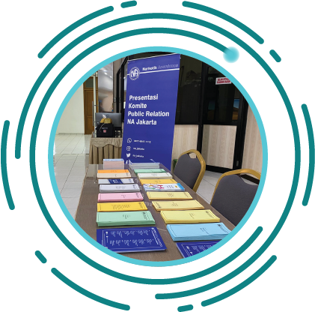
SERVICE MATERIAL
This section will help focus a Service Tools project for this cycle
May also help set future work/project plans
In recent years, the focus has moved to “basics” that are easier to translate
Notes:
The Service Material section of the survey will help the WSC prioritize the focus of a service tools project for the upcoming cycle, and it may help set possible priorities for future work/project plans. Virtual Meeting Basics, which is posted at www.na.org/virtual and na.org/basics, was created during the pandemic as a direct result of our experience and the responses to the CAR survey.
アンケートのサービス資料セクションは、WSCが次期サイクルのサービスツールプロジェクトの焦点のうち、何を優先するかを決めること、また、将来の作業/プロジェクト計画の可能な優先順位を設定することに役立つかもしれない。www.na.org/virtual と na.org/basics に掲載されている Virtual Meeting Basics は、パンデミックの最中に、私たちの直接の経験と CAR アンケートへの回答を基に作成されたものです。
NA service material used to be dominated by weighty handbooks—those are posted at www.na.org/handbooks. In more recent years, world services has been collecting best practices in shorter, easier-to-translate “basics”—those are posted at www.na.org/basics. The basics are accessed more frequently online than longer service material is, and they are well suited to our diverse and international membership.
NAサービスの資料は、以前は重厚なハンドブックが主流だった-それらは、www.na.org/handbooks に掲載されている。近年、ワールドサービスでは、実践法ベストをより短く、翻訳しやすい「ベーシック」にまとめている。これらは、www.na.org/basics に掲載されている。ベーシックスは、長いサービス資料よりもオンラインで頻繁にアクセスされ、多様で国際的な会員に適しています。
While ideas for new service tools are valuable, we also have a lot of very old service material that still contains helpful ideas but needs to be updated to reflect current experience and reality.
Based on this, the service material section is also divided into ideas for new pieces and ideas for revisions.
新しいサービスツールのアイデアも貴重ですが、非常に古いサービス資料の中には、まだ役に立つアイデアが含まれているもの、現在の経験や現実を反映させるために更新が必要なものもたくさんあります。
これを踏まえて、サービス資料のコーナーも「新作のアイデア」と「改訂のアイデア」に分けています。

Slide 11
PUBLIC RELATIONS
PR video explaining what NA is, how it works, and how to contact us* (2020)
Our public image: creating confidence in NA
More social media guidelines above and beyond the service pamphlet
More short, focused PR resources such as tools to assist in reaching the medical community, criminal justice, and those who refer people to NA
Sponsorship behind the Walls basics
Internal PR basics
Cooperation, not affiliation—our relationship to others, including AA
[NA SERVICES 101 follows PUBLIC RELATIONS in actual form]
LEGAL, FINANCIAL, AND SEVENTH TRADITION TOOLS
Self-support in NA (what it means, how we handle funds, banking, digital fund flow, fundraising, misappropriation, etc.)
Information for creating legal entities/incorporating
How do we protect the NA message and carry the message? (understanding the FIPT and the issues around illicit literature, local websites, virtual meetings, etc.)
Area treasurers’ and budgeting basics
NA SERVICES 101
Virtual service basics (including virtual service meetings, virtual meetings and areas participating in the service system, virtual workshops and trainings, etc.)
The impact of technology on services and workloads
Best practices for service workshops
Carrying the NA message effectively
Personal application of Concepts and Traditions, as a member and trusted servant
Facilitation basics
What is NA World Services and how does it work?
Fellowship development basics
Collaborating among service bodies
When service bodies split or reunify
Description of service commitments at areas and regions
Effective report writing
Tools for leadership and mentorship, including as they relate to service bodies and new meetings
Group support forum, local service
conference and local service board basics
Policy in NA—different kinds of policy styles
and approaches
New Service Material
choose up to 3
Pause for discussion
Notes:
This is the full list of items in the New Service Material section of the survey. Please select up to three options.
アンケートの「新サービス資料」の全項目です。最大3つまで選択してください。

Slide 12
REVISE EXISTING SERVICE MATERIAL
Update A Guide to Local Services in NA (GLS )
Revise Translation Basics
Revise and update Planning Basics
Revise and update PR Basics
Revise and update H&I Basics
Revise and update the service pamphlet Disruptive and Violent Behavior to reflect current practices in the Fellowship, and include the issue of sexual predators
Revise and update the service pamphlet Group Business Meetings, with a section on using a CBDM process, and the concept of delegation
Other
Revisions to Existing
Service Material
choose up to 2
Pause for discussion
Notes:
This is the full list of items in the Revisions to Existing Service Material section of the survey. Please select up to two options.
アンケートの「既存サービス資料の改訂」の全項目です。最大2つまで選択してください。

Slide 13

ISSUE DISCUSSION TOPICS
Issues discussed between Conferences
Results of the discussions create the foundations for service tools and literature projects
Notes:
Issue Discussion Topics (IDTS for short) are just that—issues that are discussed throughout the Fellowship in the time between Conferences. The results of IDT workshops and discussions can help to create the foundation for service pamphlets and other tools and literature. Sharing your priorities will help the WSC select Issue Discussion Topics for the upcoming Conference cycle.
イシュー・ディスカッション・トピックス（IDTS）とは、大会と大会の間にフェローシップ全体で議論される課題のことです。IDTのワークショップやディスカッションの結果は、サービスパンフレットやその他のツールや文献の基礎となります。優先事項を共有することで、WSCが次の大会サイクルの「問題点討論トピックス」を選ぶ際に役立ちます。

Slide 14
IDTS FOR THE NEXT CYCLE
Gender-neutral and inclusive language in NA literature
Reimagining and revitalizing service committees (to further the reach of the NA message, improve communication, provide mentorship and training, and make service more attractive and accessible, learning from our experience the past few years)
Dealing with disruptive and predatory behavior
Self-support in NA: Seventh Tradition and Eleventh Concept
The Fellowship Intellectual Property Trust (FIPT )
Our Symbol—a closer look
The importance of our Traditions to NA
Group conscience and consensus-based decision making
PR basics—what they are and why they are important
Spiritual principles and service
Social media and PR issues
Making NA accessible for those with additional needs
Building our unity while respecting our differences
Retaining members in NA
Illness/medication and our literature
Other
Issue Discussion Topics
choose up to 3
Pause for discussion
Notes:
This is the full list of items in the Issue Discussion Topic section of the survey. Please select no more than three options.
本調査の「問題点討論トピックス」の全項目です。選択肢は3つまででお願いします。

Slide 15

REMINDER: 1 APRIL 2023
As a reminder, the survey is available until this date
www.na.org/survey
Notes:
As a reminder, we will collect responses from members and from regions and zones until the first of April 2023. You can access the survey at www.na.org/survey.
注意事項として、2023年4月1日まで、メンバーおよびリージョンとゾーンからの回答を収集します。アンケートは、www.na.org/survey からアクセスできます。

Slide 16

Six other PowerPoints available online
CAR survey also available online
CAR available for download
      worldboard@na.org
      www.na.org/conference
Notes:
We hope this PowerPoint has helped in your discussion of this material. Please note there are other PowerPoints that focus on other CAR contents. These resources, the Conference Agenda Report, and the CAR survey are available online at www.na.org/conference.
この PowerPoint が、この資料の議論に役立てば幸いです。CAR の他のコンテンツに焦点を当てたパワーポイントもございます。これらの資料、Conference Agenda Report、CAR survey は、www.na.org/conference でオンライン公開されています。
We welcome your questions and your feedback on the CAR, and all other issues at worldboard@na.org.
CAR、およびその他のすべての問題についてのご質問、ご意見を worldboard@na.org でお待ちしています。

